Slide 1

Burn Mass Casualty and Burn Surge Disaster Preparedness Course
Hazards that can lead to a Burn Disaster and historical Examples, Case Studies
September 2021

Slide 2


Disclosures
In relation to this presentation, I declare that there are no conflicts of interest and, no off-label use of medications will be discussed
The content of this work focuses on general surge topics is based in part on the research of Hick & Hanfling et al. Terrorism, burn and blast trauma injury information is based on the research of Peleg et al. The burn surge content is based on the research of Kearns et al. Academic sources are included at the end of the presentation.
Cases selected for demonstration are based on either personal experiences or extensive research of the event
Medical care discussed in this content represents information commonly found in current academic sources at the time it was developed. All medical care and medical practice should be reviewed by a physician for currency and accuracy
A conflict of interest is any situation in which a speaker or immediate family members have interests, and those may cause a conflict with the current presentation. Conflicts of interest do not preclude the delivery of the talk, but should be explicitly declared. These may include financial interests (eg. owning stocks of a related company, having received honoraria, consultancy fees), research interests (research support by grants or otherwise), organisational interests and gifts.

Slide 3

5 Things from this module
The historical events presented in this work are examples of what can take place in most locations in your state
While some parts of the country are more prone to certain weather disasters than others, the threats from fire are hazards all communities share
Regulations continue to improve safety and limit certain risks but there will always be someone somewhere who considers the cost of compliance too steep
Several burn scenarios pose substantial risks to rescuers as well, don’t forget scene safety
What relationships do you have with your mutual aid partners? Referral hospitals? Burn or Trauma Center(s)? During the event is not the time to create one.

Slide 4

Overview, Top 6 Factors for a BMCI
Structure Fire: The most common form of a burn disaster or burn mass casualty incident (BMCI) is a structure fire

Slide 5
Overview cont.
Terrorism: The simplest way to instill terror in others includes the use of incendiary devices leading to explosions and fires

Slide 6
Overview cont.
Earthquake: when buildings collapse and the foundations tear open, utilities such as gas and electrical lines can create a deadly mix.

Slide 7
Overview cont.
Transportation Accident: the most common fuel for cars, trucks, and airplanes is highly flammable and fiery collisions can occur.

Slide 8
Overview cont.
Chemicals: certain chemicals can cause contact and inhalation injuries

Slide 9
Overview cont.
Nuclear/Radiation: important to distinguish between nuclear and radiation; rapid release of nuclear energy produces a thermal wave that will burn anything, and anyone impacted by the wave. However, industrial and medical radiation will not produce a burn injury (short term)

Slide 10

Historical Events
Structure Fire
Terrorism
Earthquake
Transportation Accident
Chemicals
Nuclear/Radiation

Slide 11
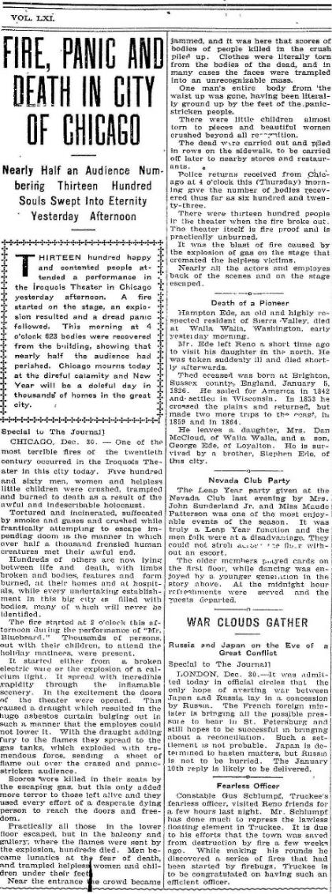
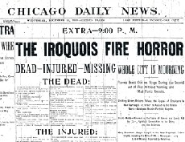
Chicago
Iroquois Theater Fire
  Dec. 30, 1903
  605 Killed
  250 (est.) Injured
  Broken light, ignited curtains

Slide 12
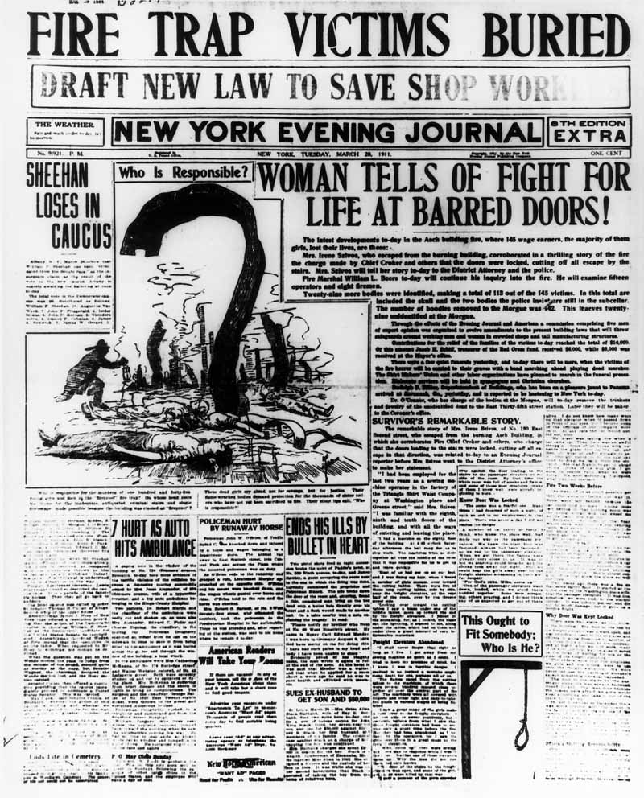
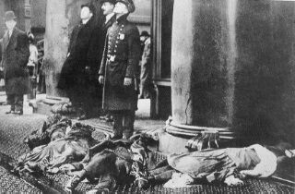
New York
  Triangle Shirtwaist Factory Fire
  Mar. 25, 1911
  146 Killed
  71 Injured
  Discarded Cigarette or
  Sewing Machine Motor

Slide 13
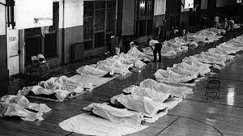
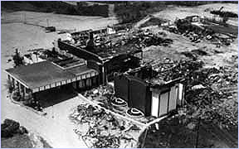
Cincinnati (Southgate Ky)
Beverly Hills Supper Club Fire
  May 28, 1977
  165 Killed
  200+ (est.) Injured
  Electrical fire, smoldered in drop ceiling before flashover, approximately 3000 people were in the various venues for the multiuse building at the time of the fire.

Slide 14
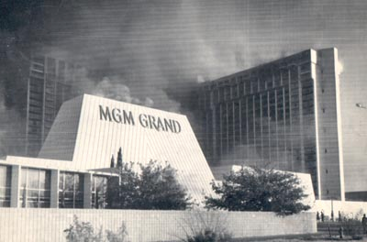
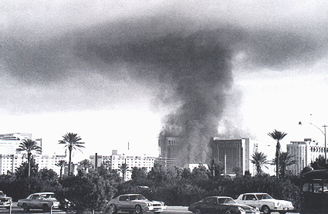
Las Vegas
MGM Grand Hotel and Casino
  Nov 21, 1980
  85 Killed
  613 Injured (+14 firefighters)
  Unknown source (began in restaurant)

Slide 15
Historical Events
Structure Fire
Terrorism
Earthquake
Transportation Accident
Chemicals
Nuclear/Radiation

Slide 16
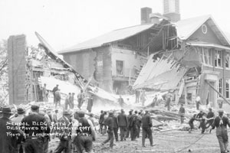
Bath, Michigan
Bath School Bombing
  May 18, 1927
  45 Killed
  58 Injured
  Disgruntled school board member, angry with taxes, places and activates multiple dynamite bombs in Bath School (most bombs did not detonate)

Slide 17
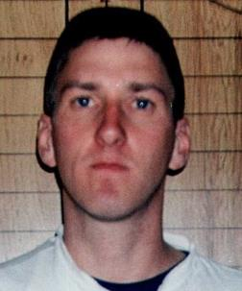
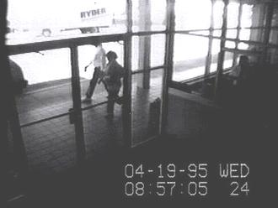
Oklahoma City
Murrah Federal Building Bombing
  April 19, 1995
  168 Killed
  111 Injured
  Timothy McVie. He hoped to inspire a revolution against the federal government and defended the bombing as a legitimate tactic against what he saw as a tyrannical government.

Slide 18
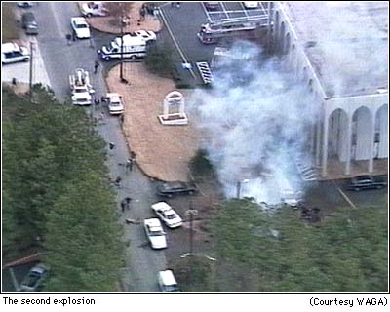
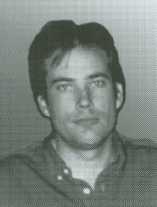
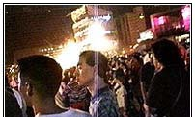
Atlanta
Olympics Bombing
  July 27, 1996
  2 Killed
  111 Injured
  Eric Rudolph (Army of God). Subsequently bombed abortion clinics in Atlanta, Birmingham and a lesbian nightclub in Atlanta. Considered by most as the first to set a secondary device to harm first responders.

Slide 19
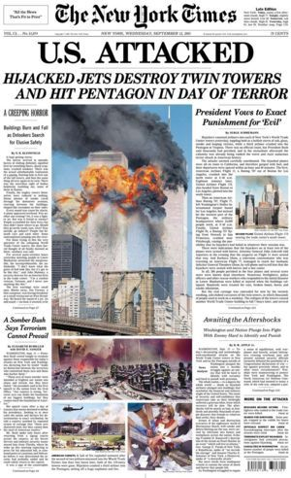
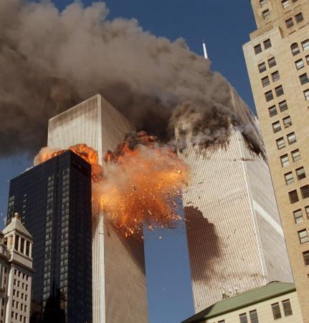
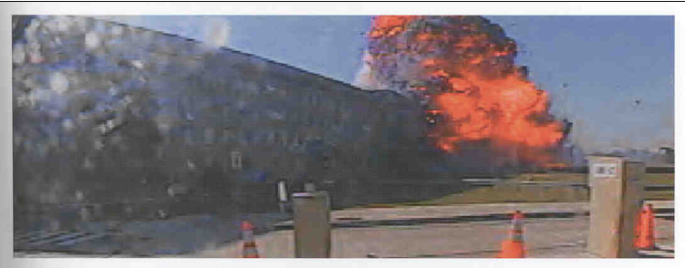
New York and Washington DC
September 11 Attacks
  Sep 11, 2001
  2996 Killed
  6000 est. Injured
  A series of four coordinated terrorist attacks by the Wahhabi Islamist terrorist group Al-Qaeda against the United States relying on a team of 19 foreign terrorists who commandeered four airplanes for their attack

Slide 20
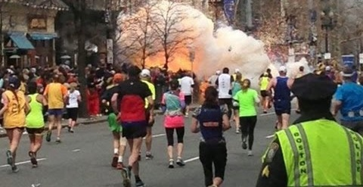
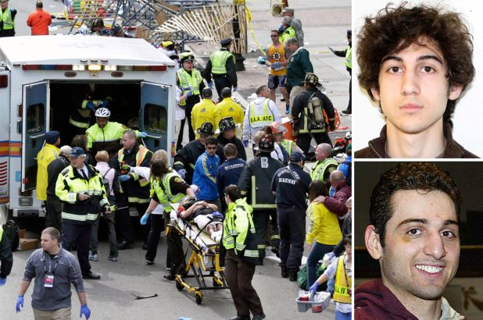
Boston
Boston Marathon Bombings
  Apr 15, 2013
  3 Killed
  264 est. Injured
  2 Homemade Pressure Cooker Bombs with timers, placed near the finish line for the marathon, retribution for U.S. military action in Afghanistan and Iraq, Dzhokhar Tsarnaev and Tamerlan Tsarnaev.

Slide 21
Historical Events
Structure Fire
Terrorism
Earthquake
Transportation Accident
Chemicals
Nuclear/Radiation

Slide 22
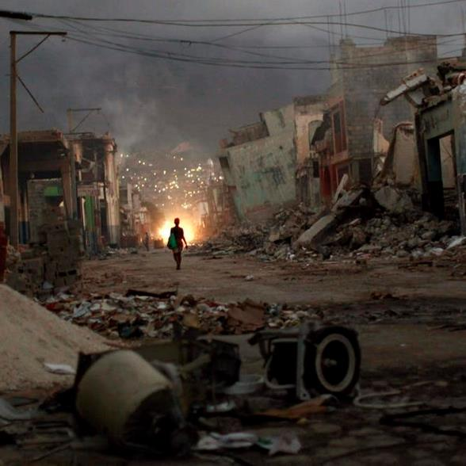
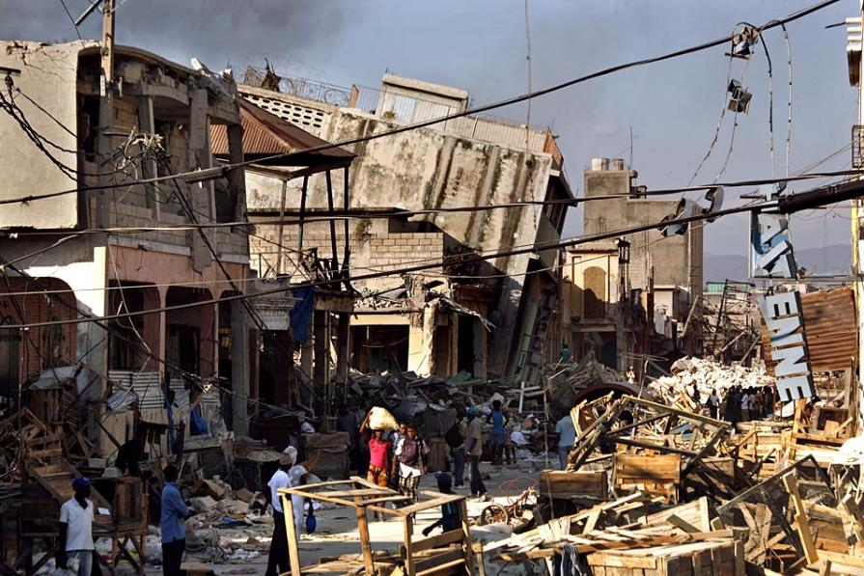
Port-a-Prince Haiti
Haiti Earthquake
  Jan. 12, 2010
  316,000 Killed
  300,000+ (est.) Injured
  7.1 Magnitude. Included in the injuries were more than 1000 Americans on the island who were evacuated to US hospitals including dozens with burn injuries. For those with burn injuries, they were flown to burn centers in Florida and North Carolina.

Slide 23
Historical Events
Structure Fire
Terrorism
Earthquake
Transportation Accident
Chemicals
Nuclear/Radiation

Slide 24
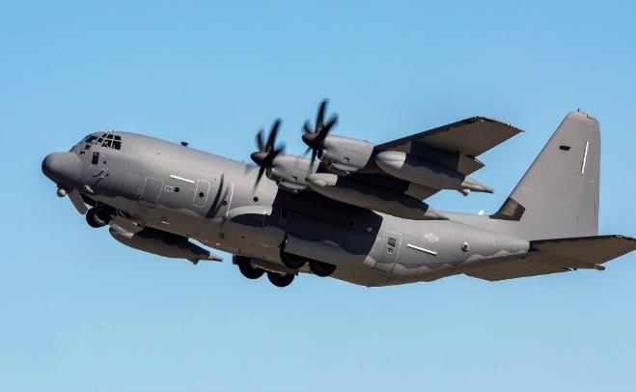
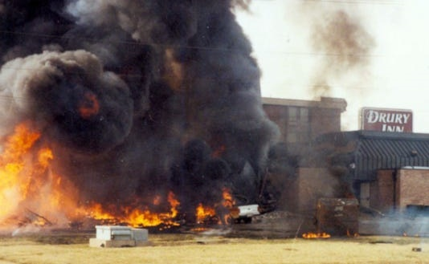
Evansville, IN
C130 Cargo Plane Crashes into Hotel
  Feb. 2, 1992
  5 killed on the airplane (everyone)
  11 killed in the hotel with 13 injured, many with burn injuries
  National Guard Cargo Plane practicing “touch and go’s” at Evansville Airport. Failed to gain altitude and crashed into a nearby hotel.

Slide 25
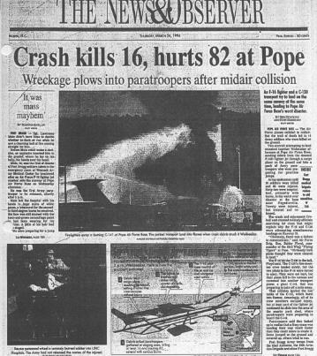
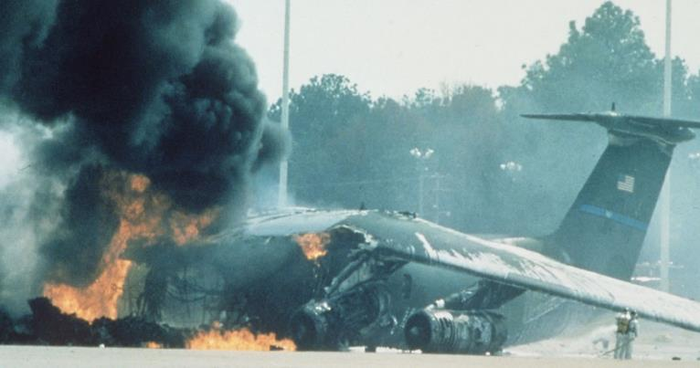
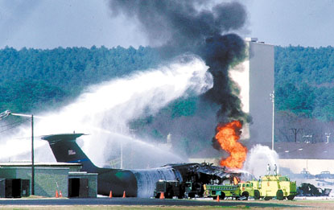
Fayetteville, NC
Tarmac Collision, Pope Air Force Base
  March 23, 1994
  24 Killed
  100+ (est.) Injured
  F-16 involved in midair collision with C-130, both attempting to land. C-130 lands uneventfully. F-16 has significant damage, pilot ejects. F-16 strikes runway, crosses parking lot and impacts C-141 parked on an adjacent tarmac being loaded with Airborne Troops.

Slide 26
Historical Events
Structure Fire
Terrorism
Earthquake
Transportation Accident
Chemicals
Nuclear/Radiation

Slide 27
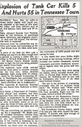
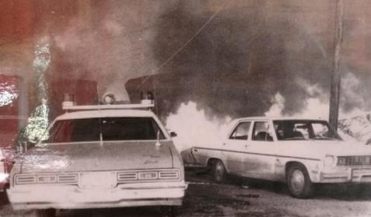
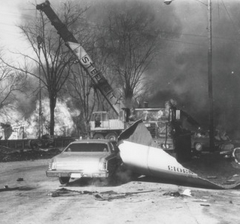
Waverly, TN
Train Derailment, Liquid Propane
February 22–24, 1978
16 Killed
43 Injured
Train derailment Feb 22. Local responders identified multiple hazardous chemical cars, but none appeared to be leaking. A team specializing in LP gas arrived Feb 24 to start the transfer. Cold (20˚F) temps previous two days gave way to warmer (52˚F) temps. While no leaks had previously been detected, a leak was identified just before the offloading was to start and a Boiling Liquid Expanding Vapor Explosion (BLEVE) occurred killing the fire chief, police chief and multiple responders, while leaving many more with burn and blast injuries.

Slide 28
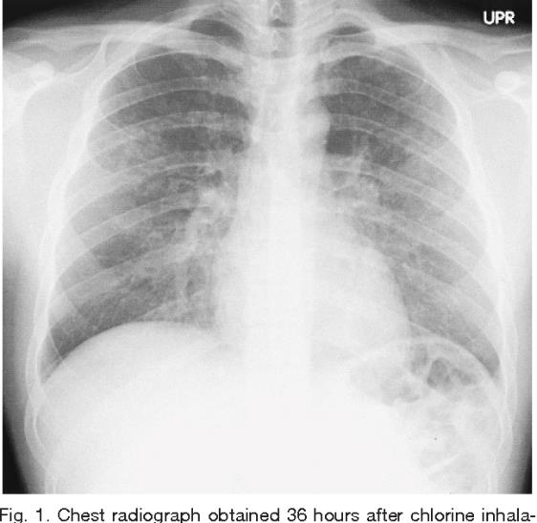
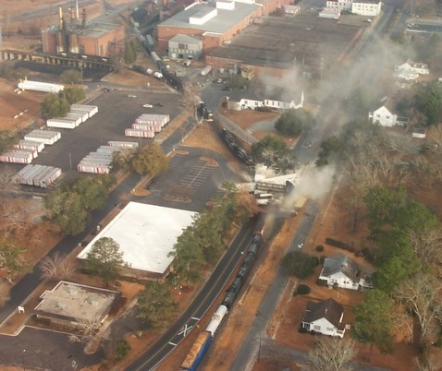
Graniteville, SC
Train Derailment, Chlorine Leak
January 6, 2005
10 Killed, mostly chlorine gas
250+ (est.) Injured
Incorrect track switch setting directed 190 car freight train into a second train that was parked on a siding. The collision and derailment released 60 tons of chlorine gas. 250 people were treated for toxic chlorine exposure, more than 5k were evacuated

Slide 29
Historical Events
Structure Fire
Terrorism
Earthquake
Transportation Accident
Chemicals
Nuclear/Radiation

Slide 30
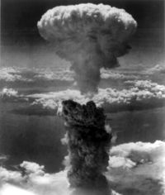
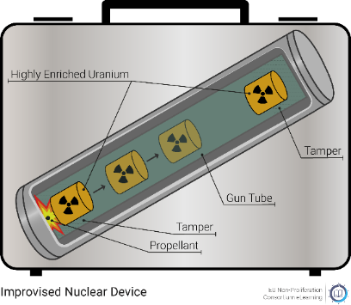
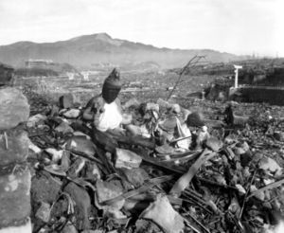
Nagasaki and Hiroshima, Japan
Nuclear Weapon Attacks
  Aug 6 & Aug 9, 1945
  129k to 266k killed (estimates vary)
  200k est. injured, mostly burn injuries
  Only use of nuclear weapons. The first yielded 16 kt of energy and the second 21 kt of energy. Current worst case scenario threats include improvised nuclear devices, “suitcase nukes.” These small yield (5-10kt) devices can produce similar damage including a thermal wave potentially leaving 10’s of thousands with burn injuries.

Slide 31
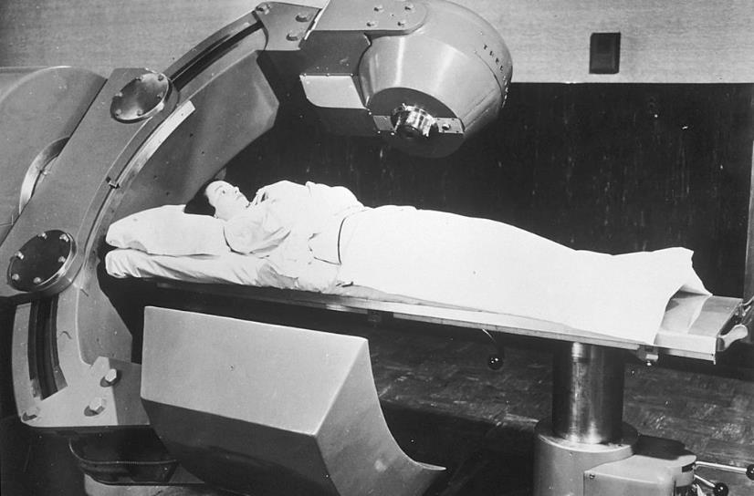
Samut Prakan, Thailand
Samut Prakan Radiation Accident
Jan-Feb 2000
  3 killed (sepsis, uncontrolled infection and
  depletion of white blood cells.)
  7 injured, developed agranulocytosis or bicytopenia (depletion of white blood cells and/or platelets). Several also developed burns after prolonged exposure to the radiation source.
  An example of extended exposure to a radiation source. A surplus Cobalt-60 radiation unit was being salvaged. The radiation source was removed, and its unique nature (glowing) was shown to multiple people involved in the salvage. Radiation sickness is the most common effect for prolonged exposure.

Slide 32

Case Studies
Four Real World Events involving scenarios that could exist in most communities.
1. Night club fire. Created in an adapted space, with little consideration for rapid evacuation. Hundreds of patrons in poorly lit area, consuming alcohol.

Slide 33
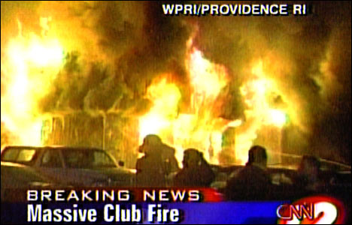
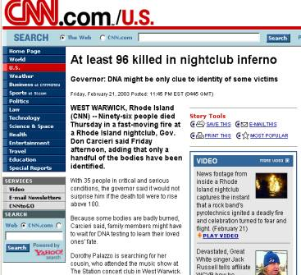
Case 1.
How much time from spark to disaster?
Station Night Club Fire
  Feb. 20, 2003
  100 Killed
  244 (est.) Injured
  fireworks
Case study on Fire in a small space with limited fire protection
National Institute of Standards and Technology (NIST) Simulation

Slide 34
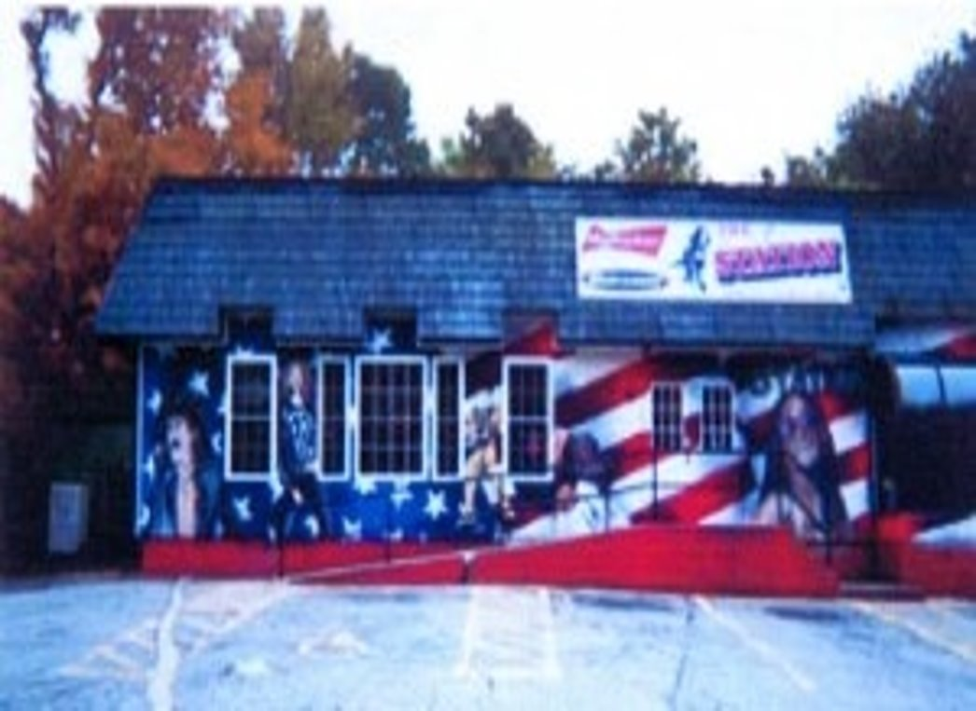

Slide 35
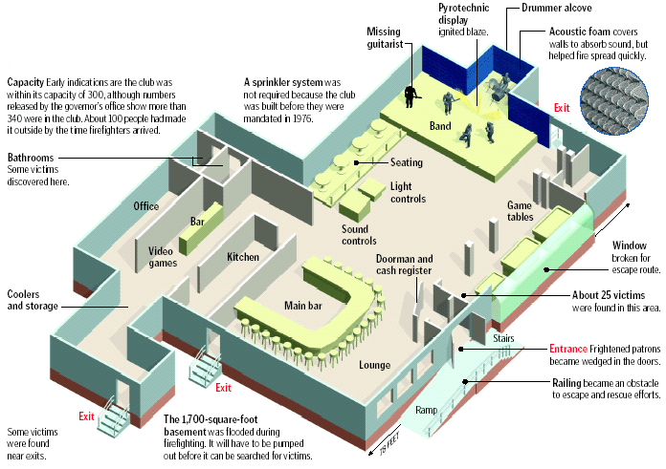

Slide 36
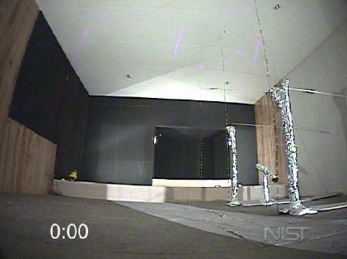

Slide 37
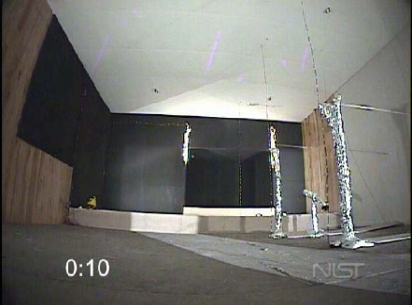

Slide 38
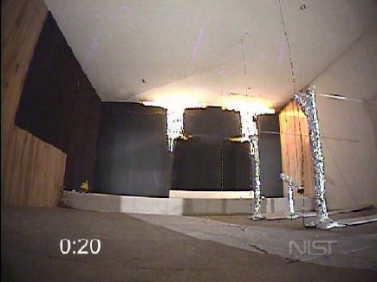

Slide 39
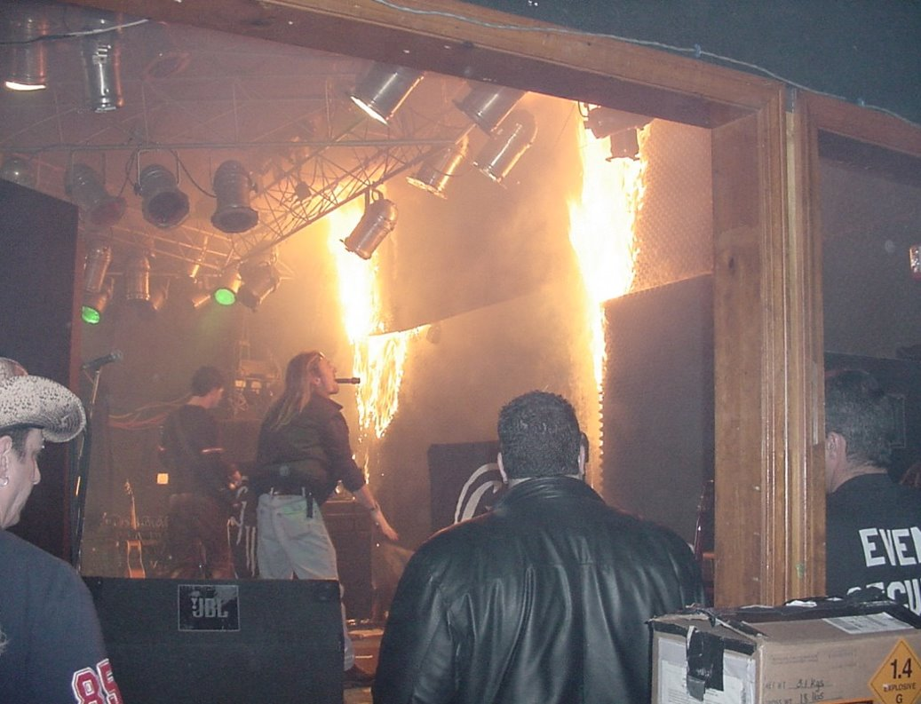
Approximately 20 seconds after ignition.
Patrons began to react to the fire at approximately 25-30 seconds
Indoor fireworks could not be located, so, a decision was made to use outdoor fireworks on stage for the show

Slide 40
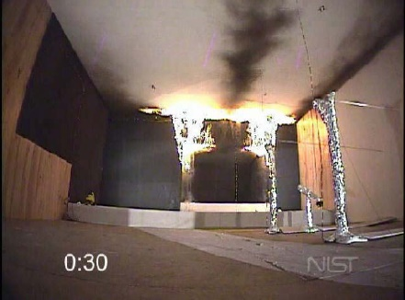

Slide 41
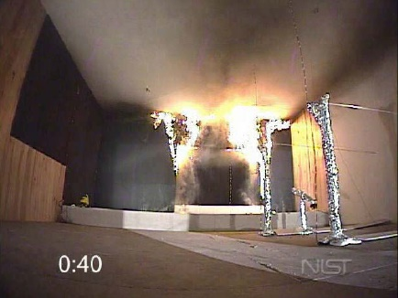

Slide 42
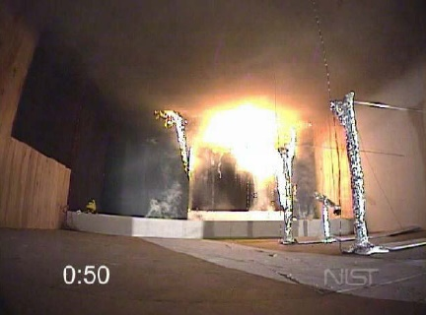

Slide 43
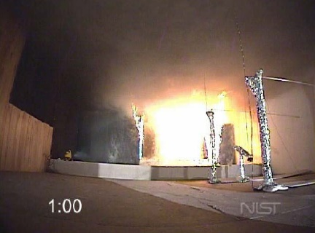

Slide 44
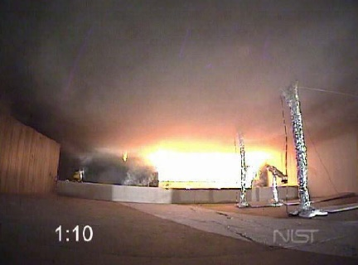

Slide 45
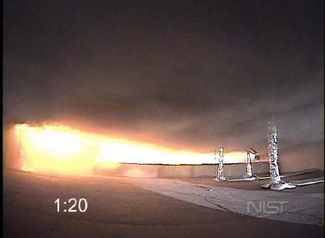

Slide 46
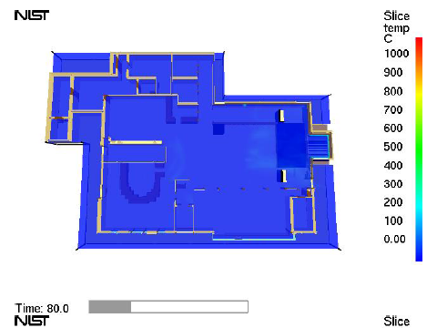

Slide 47


Slide 48


Slide 49


Slide 50
Assuming this was your town, what would you do? (Discuss)
100 killed
244 injured
Burn only event (Type III)
How many ambulances do you have and how many will you need?
Do you stay on scene and transport all patients directly from the scene to community hospitals, trauma centers and burn centers?
Do you relocate your disaster to the local hospital and start the process from there?
What is your closest hospital? Trauma Center? Burn Center?

Slide 51
Once you are alerted to this event, what are your first considerations? (Discuss)
If you are the closest EMS station.
If you are the EMS district supervisor.
If you work on a medical helicopter alerted to the event.
If you are the ED manager at the closest hospital.
If you are the ED physician at the closest hospital.
If you are the nurse manager at the closest burn center.
If you are the burn surgeon (taking call) at the closest burn center.
Other roles (insert here and discuss)

Slide 52
Case Studies cont.
Four Real World Events involving scenarios that could exist in most communities.
2. Industrial plant, dust explosion. Dust is a common byproduct for many manufacturing processes and is highly combustible. Most industries require hundreds of employees.

Slide 53

Dust Explosion, Industrial Plant
(located behind Regional Airport)
January 29, 2003
Explosion 13:27
9-1-1 caller reports maybe “300 killed”
9-1-1 caller saw military jet flying low, believed to have crashed into a pharmaceutical plant
(Fighter jets from nearby US Air Force base practicing “touch and go’s” at regional airport located immediately behind the plant)
first arriving responders, large 2 story industrial building “fully involved” “many injuries” “blew up”
Mostly rural community, population 45,000

Slide 54

Notes:
Photos from presentation by the US Chemical Safety and Hazardous Investigation Board
http://www.chemsafety.gov/index.cfm?folder=completed_investigations&page=info&INV_ID=34

Slide 55


Slide 56
Once you are alerted to this event, what are your first considerations? (Discuss)
If you are the closest EMS station.
If you are the EMS district supervisor.
If you work on a medical helicopter alerted to the event.
If you are the ED manager at the closest hospital.
If you are the ED physician at the closest hospital.
If you are the nurse manager at the closest burn center.
If you are the burn surgeon (taking call) at the closest burn center.
Other roles (insert here and discuss)

Slide 57


Slide 58
Based on this information, and your role, what would you do?
Cause: accumulated polyethylene powder above suspended ceiling (dust) exploded (USCSB June 2003)
The scenario of an airplane struck a building was later attributed in part to the post 9/11 fears as well as the touch and go’s being performed by the USAF jets and the viewpoint for several of the first callers
Fortunately, the time of the explosion coincided while a vast majority of the employees were on lunch break
On scene report, 10 red tags mix of burn and trauma, 20 yellow tags mix of burn and trauma, critical, 2 expectant, 20 green tags.
The local EMS agency committed 6 ambulances to the scene before requesting mutual aid, the closest hospital was an 8 bed ER community hospital. The closest trauma center was 100 miles east and the closest burn center was 125 miles west along with two other trauma centers close to the burn center. A total of 5 medical helicopters responded.

Slide 59


Slide 60


Slide 61


Slide 62
What they (regional trauma and burn centers) did.
5 Medical Helicopters from 3 Level I trauma Centers (2 from a Level I with Burn Center), 1 (Large) Military Helicopter (CH46E Navy)
First call to house supervisor from the scene to burn center reported all beds full, not available
Second call from local community hospital, burn center medical director reported they would “make beds” would ultimately receive 10 patients within 8 hours of explosion
1st patient arrived at burn center 16:12 with 6 total in the hour, 4 more patients between 20:00 and 22:00, 1 by air and 3 by ground, 6 admitted to Burn Center, 1 in NSICU, 2 in SICU, 1 CTICU
Level I trauma center (not a burn center admitted 6)
Level I trauma center (not a burn center admitted 12)
Community hospital saw 60, admitted 20

Slide 63

Treatment and Outcomes at the Burn Center
All pts had inhalation injuries, and all were intubated
Burn injuries ranged from 16%-62% TBSA (avg 33.6%)
Associated orthopedic injuries (2 pts); abdominal injuries (2 pts) and/or head injury (1 pt)
Seven patients survived to D/C (LOS: 15-136, avg 48 day)
Three patients died, all with combined burn/ trauma
Six patients with DVT; 2 patients with cholecystitis requiring tube; 2 patients with adrenal failure; 1 blindness

Slide 64
Treatment and Outcomes at the Burn Center
Resources of hospital and staff (especially nurses) taxed but were able to accommodate
Critical mortality: 30%
Average number of operations per patient: 3.5 ± 2.4
Length of stay: 48 days (mean), 38 days (median)
Families able to stay together (within 2 hours of home)

Slide 65
Assuming this was your town, what would you do? (Discuss)
How does this scenario apply to your community? Could this happen in your community?
In your opinion, what worked that has application to your jurisdiction or hospital?
In your opinion, what would you do differently if this occurred in your jurisdiction or hospital?
For your community, would you transfer directly to the trauma center or burn center, or to the local hospital first?
What if the scenario had 20 burn patients? 30 burn patients?

Slide 66
Once you are alerted to this event, what are your first considerations? (Discuss)
If you are the closest EMS station.
If you are the EMS district supervisor.
If you work on a medical helicopter alerted to the event.
If you are the ED manager at the closest hospital.
If you are the ED physician at the closest hospital.
If you are the nurse manager at the closest burn center.
If you are the burn surgeon (taking call) at the closest burn center.
Other roles (insert here and discuss)

Slide 67
Case Studies cont.
Four Real World Events involving scenarios that could exist in most communities.
3. Industrial plant, gas explosion. Installation of a hot water heater. Service line disconnected (some 100 ft from heater). Residual from line leaked into room with ignition source. Explosion led to structural collapse of concrete building in two locations.

Slide 68

Gas Explosion, Industrial Plant
January 9, 2009
Explosion 11:28
9-1-1 caller reports explosion, partial building collapse, many burned
9-1-1 caller confirmed 300 employees
Suburban community adjacent to large metro area, population 600,000
Multiple units (not needed and) returning to station following Amtrak vs Auto collision
11:29 1 ambulance, 1 medic unit, 1 engine, 1 FD District Chief, 1 EMS DC
  11:33 – EMS District Chief en route adds 5 ambulances
  11:36 – EMS District Chief en route requests total 10 ambulances + “EMS Truck 1” Mass casualty unit, multiple chief officers, and two physicians

Slide 69

The Building
JIC
Getty Station
40 & JSR
Green
Accountability
Collapse
Area
Collapse
Areas
Command
Post
North
Treatment
Triage, Treatment
Transportation, Staging

Slide 70


Slide 71

The Collapse Areas
Fire & smoke
from below
Broken/leaking
Ammonia pipe

Slide 72


Slide 73
Once you are alerted to this event, what are your first considerations? (Discuss)
If you are the closest EMS station.
If you are the EMS district supervisor.
If you work on a medical helicopter alerted to the event.
If you are the ED manager at the closest hospital.
If you are the ED physician at the closest hospital.
If you are the nurse manager at the closest burn center.
If you are the burn surgeon (taking call) at the closest burn center.
Other roles (insert here and discuss)

Slide 74
Let’s look at their Initial Issues
First arriving ambulances and officers drove in too close – surrounded and overwhelmed by injured and evacuees.
“Staging” established in the middle of the street – narrow, few turnarounds.
“Command” established by FD but commanded only FD resources – direction not provided to EMS resources.
Ammonia in the air.

Slide 75


“Staging”

Slide 76
Initial Actions
Six “red tag” patients identified and transported from the scene within the first ~30 minutes.
  4 to Burn Center
  2 to (Level I trauma center [not the burn center])
Additional 16 “yellow tag” patients transported over the next hour.
Additional 18 “green tag” transported.
Accountability for 323 people – moved to the Community Center
EMS phase complete at ~1430 – transition to support role

Slide 77
What went well:
Rapid transport of critical patients
Proper destinations for critical and non-critical patients
Strong (but lucky) patient /occupant accountability – ConAgra management
Strong support of other public safety agencies
Strong contribution to the JIC/public information process

Slide 78
What could be improved:
ICS setup is critical
  Command
  Staging!!!
EMS ICS must be set up even in the face of ineffective overall ICS
Initial units should not get involved in patient care until triage is complete
Senior staff should focus on ICS
Vests and 2 radios for ICS positions – STAGING on all units
Transportation and patient tracking require a full GROUP
(5+ people, not just a “Transportation Officer”)
EMS responders need REHAB also
Hospital coordination center is needed

Slide 79
Hospitals Roles
600+ bed Closest Level 1 Trauma Center) (Hospital A)
500+ bed Regional Hospital (not a Trauma Center) (Hospital B)
700+ bed Closest Burn Center also a Level I Trauma Center (Hospital C)
900+ bed Level I Trauma Center, next closest
(All within 45 miles from scene, no helicopters used due to proximity)
5 additional community hospitals from 150-300 beds in the immediate area not used

Slide 80
Hospital A 600+ Bed Level I Trauma Center
Awareness of need for coordination between affected healthcare facilities and response agencies
Opened Incident Command
Awareness of need for management of public and families
  Those who come onto campus or move between campuses
  Those who call
Management of inter-facility and response agency communications
Patients were delivered by EMS, some transferred between facilities and others self-directed
Patient tracking

Slide 81

Command Center

Slide 82


Slide 83


Slide 84
Hospital Incident Command Support Branch
Key functions for this incident
Command Section
Liaison Officer
Public Information Officer
Public Care Unit
Patient Family Care Unit
Logistics
Support Branch
Spiritual Care Unit
Operations Section
Casualty Care Unit

Slide 85

Lessons Learned
Information from the industry was invaluable
Sharing of patient information between healthcare facilities and responding agencies is critical in managing families
Families need one on one staff assigned to them
Be prepared to manage families of missing persons
Information line needs to rapidly be made available to the public

Slide 86
Hospital B 500+ Bed Regional Hospital
Awareness of need for coordination between affected healthcare facilities and response agencies
Opened Incident Command
ED quickly assessed capability and capacity
Additional staff to ED
Notifications made to ANC’s, other units
Verification from HazMat & online resources determined pt. decon was not needed.
Marketing staff to ED for media

Slide 87
Outcomes
Received a total of 20 patients
No patients admitted
6 patients transferred to burn center
Injuries were burns, fractures, lacerations
Family coordination with other facilities
Multiple media requests

Slide 88
Hospital C 700+ Bed Level I Trauma and Burn Center
Hospital in-house notification
Quick formal field notification
Prepare for reception of all acuity levels
Prepare for pts without identification
Prepare for more than reported (include self-referrals)

Slide 89
Disaster Timeline
11:30 Explosion occurred. 11:45 Burn Center surgeons and charge nurse confer to discuss who could move if needed (20 bed burn center ICU full at that time, 4 patients identified who could move to nearby Surgical ICU)
12:00, 12:04, 12:06 Trauma Alert Issued at Burn Center for incoming disaster casualties (from scene via EMS).
12:25 First of three critically burned patients and all three arrive within the next seven minutes.
13:32, 14:15 and 14:25 Burn Patients moved from ED to Burn Unit.
14:10 Trauma Alert for incoming (burn) patient from scene (rescue from debris)
14:42 Burn Patient (cleared of trauma injury suspected) transferred from Level I Trauma Center to Burn Center and arrived at Burn Center 15:45
Three remaining burn patients at Regional Hospital to be transferred, 19:45, 19:54, 20:21 Patients arrives from Regional Hospital
Notes:
89

Slide 90
Outcomes
Average Age: 45.8 years (30-65 years), Gender: 4 males, 3 Females
Average % TBSA burn: 23.7% (2%-52% TBSA)
4 with inhalation injury, 3 with > 40% TBSA burns admitted, Extremely Critical
Other injuries: patellar fracture, CT spine injury
Average LOS for 4 less serious patients: 18.75 days
3 Critical patients: 69 days (Discharged), 72 days (Discharged), and 148 days (Expired)
3 patients had tracheostomies, and were on vents 20 days out, 3 patients had escharotomies, fasciotomies, 5 patients had more than a dozen operations

Slide 91


Slide 92
Lessons Learned
Early notification was essential
EMS system involved with scene response has exceptional reputation and were prepared to bypass a Level I trauma center and a large regional hospital before arriving at the Burn Center.
How many days of supplies are on hand and does anything need to be ordered?
Resources at local burn center are routinely at or above capacity often relying on adjacent ICUs for additional capacity
Role of housekeeping cannot be overstated. To clear a room and make ready for the next burn patient requires intense cleaning and attention to detail
Hydrotherapy/debridement and securing (as well as prepping) additional operating rooms (bringing up to temperature) may be needed

Slide 93
Assuming this was your town, what would you do? (Discuss)
How does this scenario apply to your community? Could this happen in your community?
In your opinion, what worked that has application to your jurisdiction or hospital?
In your opinion, what would you do differently if this occurred in your jurisdiction or hospital?
For your community, would you transfer directly to the trauma center or burn center, or to the local hospital first?
What if the scenario had 20 burn patients? 30 burn patients?

Slide 94
Case Studies cont.
Four Real World Events involving scenarios that could exist in most communities.
4. Industrial plant, grease fire. High pressure hydraulic line repaired with low pressure fitting, when pressurized, it exploded with line falling into hot cooking grease, flash grease fire, thick smoke, exits blocked or locked

Slide 95
Fire, Industrial Plant
September 3, 1991
Grease fire at high volume chicken processing plant
Due to excessive use of the telephone, owners had disconnected outgoing landline service, no cell phones, first notification was office member who drove to nearby fire department
90 employees in the plant, using deep fryers to process “chicken parts”
Hydraulic line coupling failure, faulty repair (low pressure fitting instead of high-pressure fitting) when pressurized, it failed with line falling into fryer grease, spraying it into the air, and creating rapid combustion
Due to reported thefts, ownership had padlocked all exits and required employees to only enter/exit through front

Slide 96


Slide 97


Slide 98
Once you are alerted to this event, what are your first considerations? (Discuss)
If you are the closest EMS station.
If you are the EMS district supervisor.
If you work on a medical helicopter alerted to the event.
If you are the ED manager at the closest hospital.
If you are the ED physician at the closest hospital.
If you are the nurse manager at the closest burn center.
If you are the burn surgeon (taking call) at the closest burn center.
Other roles (insert here and discuss)

Slide 99
Let’s look at their Initial Actions
Two local (paid) fire departments respond along with three volunteer stations
Local EMS agency had 5 ambulances, all responded, all overwhelmed by 50-60 patients at the scene, called for mutual aid “anyone who can help” multiple volunteer rescue squads responded from various counties
Closest hospital (1 mi) rural hospital with one large emergency room with a curtain dividing ER1 and ER2. One RN and one MD. One transported here by EMS and others self-evacuated
Next closest hospital (3mi) 7-room ER, two RNs and one MD. Most patients either transported to or self-evacuated to this hospital. It became the coordination point for moving patients.
Medical helicopters from four trauma centers in three different parts of the state respond.
ED reports to one medical helicopter to bring ET tubes (adult) and lactated Ringers, they are out of fluids and ET tubes.

Slide 100


Slide 101


Slide 102


Slide 103
Assuming this was your town, what would you do? (Discuss)
While this occurred 40 years ago, the elements of this disaster continue to exist
How many rural hospitals are in your community who may lack sufficient amounts of IV fluids or ET tubes for an MCI
When you have patient numbers that exceed your EMS system capacity, who do you call?
When the call is over, how do you rest your staff? Mental health resources?
The chaos on the scene and at the hospitals was compounded by no patient tracking
With most patients who survived being intubated, and flown to either the burn center or trauma centers, groups of families drove as much as 300 miles to the three hospitals to attempt to visually identify a loved one
What are your plans for a temporary morgue?
Who is your spokesman for CNN, CBS, ABC, the BBC? (all called or came)

Slide 104
Outcomes
25 died, 54 injured
Patients were admitted to 3 community hospitals, and 4 trauma centers in three different regions of the state
From one of the burn centers:
  Six intubated patients admitted arrived by medical helicopters
  <10% TBSA burn, all inhalation injury
  Length of stay 3-20 (mean 8) days, all survived
  Admitted 3 additional non-disaster burn patients that day

Slide 105

Conclusion
What three things are you going to make a priority to change or improve from what you have learned from these real-world experiences?
What capacity and capability does your EMS agency/hospital have to manage 5-10 patients with multiple burn injuries?
What air resources or ground critical care transport resources can assist your organization with transportation of a burn injured victim to a burn center?
A BMCI is typically a high-profile event with news crews, family needs, etc. Does your planning effort address public information? Space for families? Pastoral or mental health support?
As you plan for managing the patients, don’t overlook planning for the mental health impact this will have on your staff. The sights, the sounds and the odors associated with a BMCI can last a lifetime.

Slide 106


5 Things from this module
The historical events presented in this work are examples of what can take place in most locations in your state
While some parts of the country are more prone to certain weather disasters than others, the threats from fire are hazards all communities share
Regulations continue to improve safety and limit certain risks but there will always be someone somewhere who considers the cost of compliance too steep
Several burn scenarios pose substantial risks to rescuers as well, don’t forget scene safety
What relationships do you have with your mutual aid partners? Referral hospitals? Burn or Trauma Center(s)? During the event is not the time to create one.

Slide 107


Questions?

Slide 108
References
1. Acosta JK, Levenson RL, Jr. Observations from Ground Zero at the World Trade Center in New York City, Part II: Theoretical and clinical considerations. International journal of emergency mental health. 2002;4(2):119-126.
2. Feeney JM, Goldberg R, Blumenthal JA, Wallack MK. September 11, 2001, revisited: a review of the data. Archives of surgery. 2005;140(11):1068-1073.
3. Kearns RD, Marcozzi DE, Barry N, Rubinson L, Hultman CS, Rich PB. Disaster Preparedness and Response for the Burn Mass Casualty Incident in the Twenty-first Century. Clinics in plastic surgery. 2017;44(3):441-449.
4. Kearns R, Zoller J, Hubble M, Alson R, Cairns B, Holmes IV J. Using Monte Carlo Simulation for Modeling Surge Capacity in the ABA Southern Region. J Burn Care Res. 2012;33(2):1.
5. Kearns RD, Conlon KM, Valenta AL, et al. Disaster planning: the basics of creating a burn mass casualty disaster plan for a burn center. J Burn Care Res. 2014;35(1):e1-e13.

Slide 109



Content for this Presentation was Created or Developed by Randy Kearns for All Clear Emergency Management Group to be used for the State of Vermont
Dr. Kearns began his career as a paramedic, rescue chief and firefighter and instructor. Over 30 years, he taught emergency services programs at several community colleges in the Carolinas, spent 8 years in hospital administration and led multiple emergency service and emergency management organizations. Dr. Kearns has been a responder to 25+ presidentially declared disasters as a local, state and federal representative. In 2014, Dr. Kearns retired (from the State of North Carolina) as a Clinical Assistant Professor at the University of North Carolina, School of Medicine. After spending four years as the Healthcare Management Program Chair and an Associate Professor at the University of Mount Olive, Dr. Kearns joined the faculty here at the University of New Orleans in the College of Business Administration, August 2018.
Publication Indexes:
PubMed
Scopus
ResearchGate
ORCID
Dr. Kearns has 81 publications in various forms. And, according to Expertscape (www.expertscape.com an academic artificial intelligence analysis software) is ranked 4rd internationally for research in “Surge Capacity” 5th internationally for research in “Mass Casualty Incidents” and 11th for his work in “Disaster Planning.”
All Clear Emergency Management Group, LLC is an experienced consulting firm that provides an array of emergency management services and conference management services. Our team of dedicated professionals will exceed our clients’ expectations.

Slide 110
Assignment of Rights
This content was developed for the All Clear Emergency Management Group for use with the State of Vermont.
Content used for this presentation, where applicable, has been sourced from various public documents or from the author’s personal materials. Copyright for papers published in academic journals, in their final form, are maintained by those respective journals.
The purpose of this project is to provide education for those involved in emergency care for those with a burn injury. Reuse of this material in their current format is restricted to All Clear Emergency Management Group for use with the State of Vermont.
All other rights to the materials are retained by the author.

Slide 111

Fair Use and Disclaimer
Images and other content found throughout this presentation are either cited for their original source, are owned by the author of this work or were commonly found on the world wide web and not identified as being protected images (copyright). These images and this content are used and protected based on the Fair Use Doctrine.
Copyright Disclaimer Under Section 107 of the Copyright Act 1976, allowance is made for "fair use" for purposes such as criticism, comment, news reporting, teaching, scholarship, and research. Fair use is a use permitted by copyright statute that might otherwise be infringing. Non-profit, educational or personal use tips the balance in favor of fair use.
If for any reason you see an image that may in fact be copyrighted or you find objectionable, please notify us immediately.

