Slide 1

Burn Mass Casualty and Burn Surge Disaster Preparedness Course
Burn Triage, Overview of triage inputs and triage decision-making Considerations
September 2021

Slide 2


Disclosures
In relation to this presentation, I declare that there are no conflicts of interest and, no off-label use of medications will be discussed
The content of this work focuses on general surge topics is based in part on the research of Hick & Hanfling et al. Terrorism, burn and blast trauma injury information is based on the research of Peleg et al. The burn surge content is based on the research of Kearns et al. Academic sources are included at the end of the presentation.
Cases selected for demonstration are based on either personal experiences or extensive research of the event
Medical care discussed in this content represents information commonly found in current academic sources at the time it was developed. All medical care and medical practice should be reviewed by a physician for currency and accuracy
A conflict of interest is any situation in which a speaker or immediate family members have interests, and those may cause a conflict with the current presentation. Conflicts of interest do not preclude the delivery of the talk, but should be explicitly declared. These may include financial interests (eg. owning stocks of a related company, having received honoraria, consultancy fees), research interests (research support by grants or otherwise), organisational interests and gifts.

Slide 3

Background
The modern era of burn care generally began in the US after World War II
Some of the first efforts to describe Mass Casualty Incidents with Burn Injuries appeared in the literature in the late 1940’s

Slide 4
Background cont.
While disasters occurred, and research continued to report various developments through the 1990’s, it was the September 11, 2001, attack that redefined the focus for disaster planning efforts across all disciplines

Slide 5
Background cont.
This includes Burn Disaster Planning and Burn Triage. The first edition of a triage guide for significant numbers of patients with burn injuries was published in 2005.
This work will review evolutions and later revisions as well as the basics of burn triage.

Slide 6
Overview
Burn triage (is a secondary triage) and focuses on the extent of partial thickness (2nd degree) and full thickness (3rd degree) burns a patient has sustained in the context of how survivable the injury.

Slide 7
Overview cont.
What’s in a Name. Burn injuries in the academic literature are more commonly described as “superficial,” “partial-thickness,” “deep partial-thickness” and “full-thickness”. A deep partial-thickness burn is a diagnosis that is difficult to fully determine in the emergent setting and treated no different in that setting regardless of diagnosis.

Slide 8
Overview cont.
For the sake of simplicity, we tend to use 1st degree (superficial), 2nd degree (partial thickness) and 3rd degree (full thickness). Rarely used we also find 4th, 5th and 6th degree burns which can be used to describe burn into the muscle and bone but again, offer no usefulness in the emergent setting. Thus, 1st, 2nd, and 3rd degree offers the simplest and yet most effective approach.

Slide 9
Overview, Predicting Mortality
Early 1960’s, prediction of mortality was described, later to be known as the “Baux Score” (computed by adding the age with the TBSA of 2nd and 3rd degree burns = [in percentage] the likelihood of mortality)
  An example; 25-year-old male with 40% TBSA (25 + 40 = 65%). So, the likelihood of mortality was 65%.
  Baux Score first published in a Masters Thesis in 1961 (Serge Baux) has been modified multiple times and currently referred to as the “Modified Baux Score” or the “Modified Revised Baux [R-Baux] Score” to mathematically account for the improvements in care and outcomes.

Slide 10
Overview, Predicting Mortality cont.
  Additional efforts have been made to account for other factors that have been shown to impact outcomes such as inhalation injury, preexisting conditions, etc.
  The updated Charlson comorbidity index has also been included with various measures but again, has proven to be difficult to use in emergent conditions with many variables.
  An easy to use, simple approach was the basis for the tables we will discuss shortly. Other factors such as suggested by the Charlson comorbidity index should be considered by a physician or other clinician skilled in complex assessments (if needed)

Slide 11

5 Things from this module
The two most significant predictors of outcomes following a burn injury is TBSA and age.
The three most common mistakes in managing a burn injury are incorrect TBSA assessment, hypothermia and excessive resuscitation
There are far fewer burn beds than trauma beds in the US healthcare system
For blast injuries, burn injuries may be distracting and lead to overlooking traumatic injuries
Rule of nines is the simple and easiest approach for emergency assessment for the TBSA

Slide 12
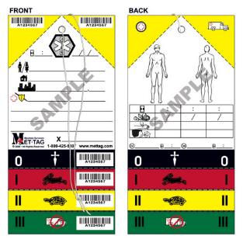
(Burn) Triage
The word triage comes from the French word trier, which means to sort or select.
Its historic roots for medical purposes go back to the days of Napoleon when triaging large groups of wounded soldiers was necessary.

Slide 13
(Burn) Triage cont.
With burn care there are aspects of burn injury to include with your primary assessment (we will discuss)
Generally, what we refer to as “burn triage” is a secondary triage system for determining who is a priority for referral to a burn center
For single burn injured patients, it’s simple. For dozens, hundreds or more, there is more to consider.

Slide 14
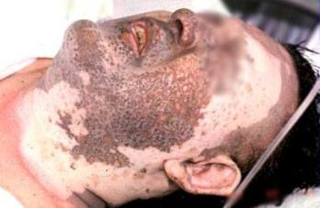
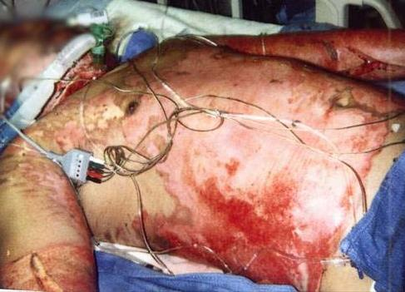
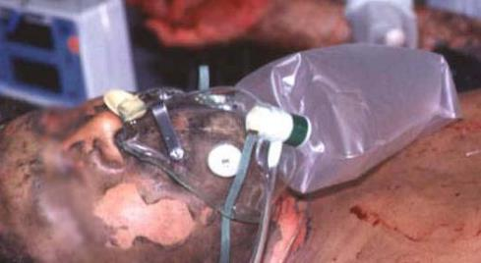
Initial Assessment (Triage One Patient)
(basically, same approach as with all other traumatic situations)
Scene Size Up
  Scene safety (electrical, chemical, HazMat, etc.)

Slide 15
Initial Assessment (Triage One Patient) cont.
Primary Survey
  Airway (obtain/maintain open airway)

Slide 16
Initial Assessment (Triage One Patient) cont.
  Breathing (assess for circumferential burn and administer high flow humidified O2)

Slide 17
Initial Assessment (Triage One Patient) cont.
  Circulation (IV Access LR and assess distal circulation)

Slide 18
Initial Assessment (Triage One Patient) cont.
  Disability

Slide 19
Initial Assessment (Triage One Patient) cont.
  Exposure

Slide 20
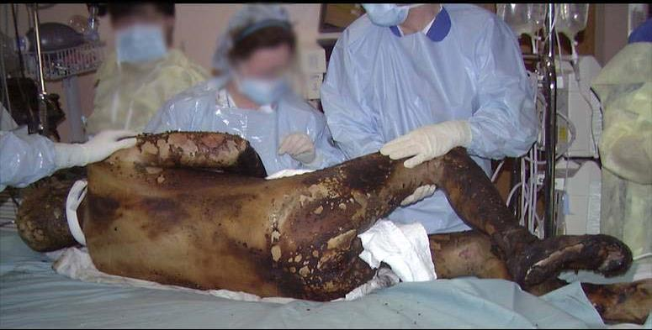
Consider Trauma as Concomitant Injury
Assess for internal/external hemorrhage
Burn injury can be distracting, burns are a cause of mortality but typically after patients exsanguinate
Assess for trauma associated with falls, or other attempts to escape the flames
Very large burn injuries typically have poor outcomes

Slide 21
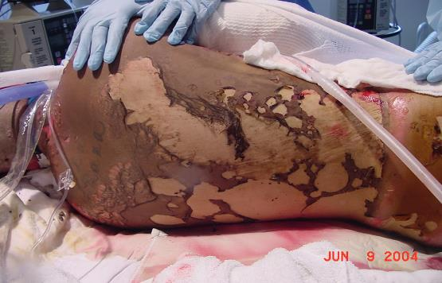
Thermal Burn
is the most common burn injury
Remove the victim from danger, extinguish and remove clothing

Slide 22
Thermal Burn cont.
Use water as needed to take the heat out of the burn (stop the burning process), do not apply wet dressings; leads to hypothermia
Airway management (if intubated, the patient will need an NG tube)
TBSA Evaluation/Fluid Resuscitation (include only partial thickness and full thickness burns, do not include superficial burns in TBSA calculation)

Slide 23
Thermal Burn cont.
Pain Management
Normothermia – keep the patient warm
Appropriate Transport Destination
  Differentiate with Traumatic Injuries

Slide 24
Chemical Burns
Kearns RD, Cairns CB, Holmes JH, Rich PB, Cairns BA. Chemical burn care: a review of best practices. EMS world. 2014;43(5):40-45.
A key triage feature of a patient with a chemical burn includes scene size up and assessment to determine if there is an ongoing threat to the responders.
As with all events, scene safety is first evaluated and immediately followed by patient assessment. This includes assessing responsiveness, airway patency and respiratory effort. Pay particular attention to the nose and mouth for signs of inhalation injury, or for evidence of inhalation/ingestion of a chemical or caustic agent. Is there unusual mucus or saliva?

Slide 25
Chemical Burns cont.
Kearns RD, Cairns CB, Holmes JH, Rich PB, Cairns BA. Chemical burn care: a review of best practices. EMS world. 2014;43(5):40-45.
Are there noticeable sounds associated with respiratory effort or efforts to talk such as stridor, rales (crackles), wheezing, dysphonia (hoarseness) or aphonia (inability to speak)?
Is the respiratory rate too fast or too slow? Is the pulse rate too fast (tachycardia) or too slow (bradycardia)? Are there signs of shock and are there concomitant traumatic injuries such as could be sustained following a fall?

Slide 26
Chemical Burns cont.
Kearns RD, Cairns CB, Holmes JH, Rich PB, Cairns BA. Chemical burn care: a review of best practices. EMS world. 2014;43(5):40-45.
If the chemical agent is still on the patient or if you are unsure, the first step in gross decontamination is to remove clothing while being careful to not contaminate other areas of the patient or nearby responders.
Gross decontamination can be easily and quickly accomplished simply by clothing removal, physical relocation from the at-risk environment, and rinsing off the exposed areas of the body. The recommended sequence is; Strip, Flush, and Cover.

Slide 27
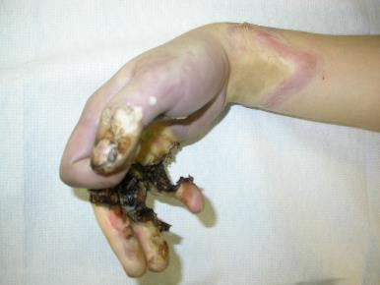
Electrical Burns
Kearns RD, Rich PB, Cairns CB, Holmes JH, Cairns BA. Electrical injury and burn care: a review of best practices. EMS world. 2014;43(9):34-40, 55.
If the patient is still in contact with an energized source, do not touch the patient until the source has been removed or disconnected.
Following the primary survey, a complete head to toe physical examination includes identifying the different contact points (surface burn sites), assess for fractures and neurological deficits (also caused by the electric shock), and begin monitoring the patient’s cardiac rhythm (electrocardiogram [ECG]). The electrical pathways of the heart may be interrupted, disturbed or damaged during electrical shock or electrocution. The cardiac damage can be manifested as dysrhythmias while the CNS damage can result in seizures, paralysis and apnea.

Slide 28
Electrical Burns cont.
Kearns RD, Rich PB, Cairns CB, Holmes JH, Cairns BA. Electrical injury and burn care: a review of best practices. EMS world. 2014;43(9):34-40, 55.
Examine the body for thermal burn injuries. Causes include contact points with the electrical source or ground, or injuries from either arc or thermal wave. Burn injuries caused by an arc or thermal wave resemble and should be managed as thermal burn injuries associated with a blast injury.
The particular pathway for electric current as it passed through the body during an electric shock will determine the tissues at risk. In addition to the voltage, the resistance to the electric current and the duration of its exposure will determine the amount of energy that is converted to heat (Joules effect). The greater the Joules effect, the greater the potential for external injury at contact points as well as substantial internal burn injury.

Slide 29
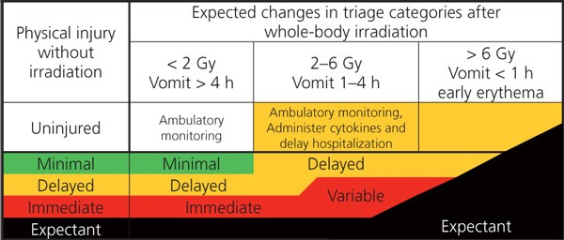
Radiation Injury
Kearns RD, Sugarman S, Cairns CB, Holmes Th JH, Cairns BA, Rich PB. Radiation Injury, Burns and Illness: A Review of Best Practices. EMS world. 2016;45(10):52-59.
Life/limb/vision-saving medical care is the priority and should not be delayed for decontamination of radioactive materials. The order of decontamination should be 1) wounds, 2) facial orifices, and 3) intact skin.

Slide 30
Radiation Injury cont.
Kearns RD, Sugarman S, Cairns CB, Holmes Th JH, Cairns BA, Rich PB. Radiation Injury, Burns and Illness: A Review of Best Practices. EMS world. 2016;45(10):52-59.
Acute Radiation Syndrome (ARS) “radiation sickness” is not contagious. The risk to the responder is limited and primarily focused on the initial source that may have been at the scene where the patient was injured.

Slide 31
Radiation Injury cont.
Kearns RD, Sugarman S, Cairns CB, Holmes Th JH, Cairns BA, Rich PB. Radiation Injury, Burns and Illness: A Review of Best Practices. EMS world. 2016;45(10):52-59.
For radiation exposure, an initial assessment must include measuring and reporting the time lapse between exposure and time to emesis (TE). The latent onset or absence of nausea and vomiting (emesis) is associated with a greater likelihood of survival. (TE is a good indicator but not a sole determinant and requires more testing.)
In addition to TE, other potential signs/symptoms include the onset and intensity of a headache, evaluated body core temperature (hyperthermia/hypothermia), diarrhea, neurological/cognitive deficits and hypotension.

Slide 32
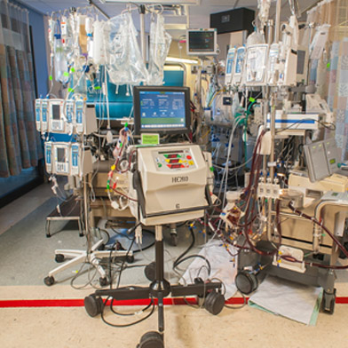
Complications and Poor Outcomes in Burn Care
Over-resuscitation: Caused by overestimation of TBSA (which leads to excess fluid resuscitation, not KVO but also not wide open)

Slide 33
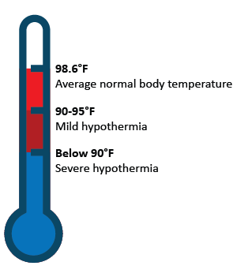
Complications and Poor Outcomes in Burn Care continued;
Hypothermia: Caused by excessive use of cool or cold water to manage pain. Use water as needed to stop the burning process (judge temp by palpating skin adjacent to burn injury). Once the burn has been stopped, use medications to manage pain. Excessive cooling with water leads to hypothermia

Slide 34
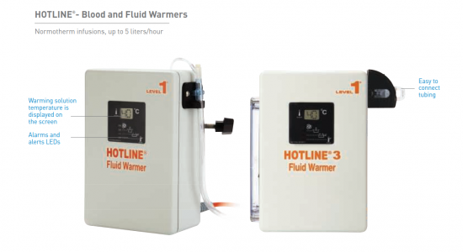
Complications and Poor Outcomes in Burn Care continued;
Hypothermia Part 2: When the covering of the body (skin) has been substantially damaged, the body loses much of its thermoregulation capability, treat and transport in a warm environment for large burns, consider fluid warmers

Slide 35
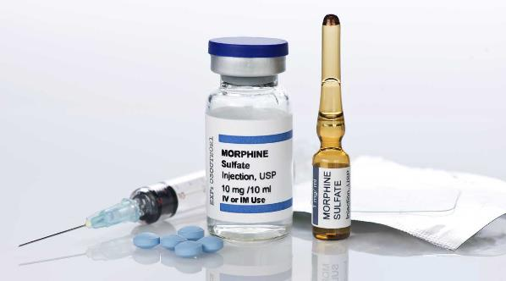
Complications and Poor Outcomes in Burn Care continued;
Underestimation of pain management: (use of paralytics for intubation without concurrent use of pain medication)
Follow your local protocols, MSO4 has been a common choice for many years but there are other options; Ketamine, Fentanyl, etc.
Key issues, keeping the patient pain free, monitor for side effects, and remember, paralyzed does not mean pain-free.

Slide 36
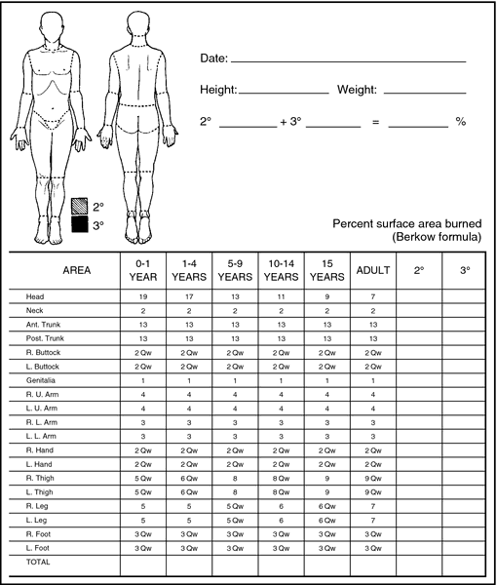
Total Body Surface Area (TBSA) Assessment
Recommend Rule of 9s outside the hospital
  More timely, easier to remember, preferred method in urgent, lifesaving environment
Lund-Browder more commonly used in the hospital
  More accurate, requires more time to do detailed assessment

Slide 37
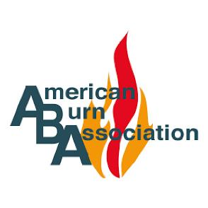
Referral Criteria: American Burn Association
  2nd degree burns > 10% TBSA
  Burns to face, hands, feet, genitalia, perineum, major joints
  3rd degree burns
  Electric injury (lightning included)
  Chemical burns
  Inhalation injuries
  Burns accompanied by pre-existing medical conditions
  Burns accompanied by trauma, where burn injury poses greatest risk of morbidity or mortality.
  Burns to children in hospitals without pediatric services.
  Patients with special social, emotional or rehabilitative needs.

Slide 38
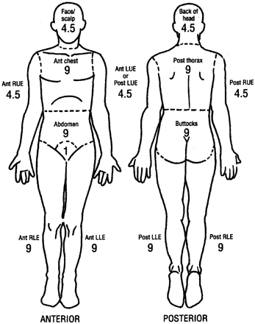
Extent of Burn
Rule of 9s
Adult only
Partial and Full Thickness only
Palmar surface = 1%
  (surface of the palm for the patient is generally equal to 1% of TBSA

Slide 39
From One to Many
Burn Triage in a Mass Casualty Setting

Slide 40
BMCI vs Burn Disaster vs MBC
A burn mass casualty incident (BMCI) occurs when the number of patients with a burn injury from an incident exceed local capacity to manage them
Other common terms or phrases used to describe a BMCI include;
Burn Disaster
Mass Burn Casualty (MBC)
For the purpose of this work, we will use BMCI, but all are commonly interchanged in the academic and guidance literature

Slide 41
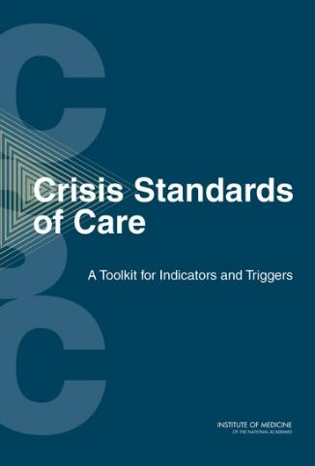
BMCI Overview
  Burn mass casualty incidents (BMCI) produce a sudden surge of burn-injured patients that will stress healthcare resources, including supplies, space, and experienced workforce.
  Existing guidelines for standard of care and catastrophic circumstances fail to account for contingency and crisis situations.
  This work attempts to align existing data with recommendations of the Committee on Crisis Standards of Care for the Institute of Medicine, National Academies of Sciences.

Slide 42
Classification of a Burn Disaster or Burn Mass Casualty Incident follows the National Incident Management System (NIMS)³⁷
Type III Burn Disaster or BMCI | Mass casualty incident that only or primarily includes patients with burn injuries such as a night club fire.
This information has been used in various publications related to BMCI planning and preparedness activities. It is based on the NIMS classification system that is used for all “resource typing” as defined in the NIMS process. ^{28,31}

Slide 43
Classification of a Burn Disaster or Burn Mass Casualty Incident follows the National Incident Management System (NIMS)³⁷
Type II Burn Disaster or BMCI | Mass casualty incident that includes patients with both burn injuries as well as other non-burn related trauma.
This information has been used in various publications related to BMCI planning and preparedness activities. It is based on the NIMS classification system that is used for all “resource typing” as defined in the NIMS process. ^{28,31}

Slide 44
Classification of a Burn Disaster or Burn Mass Casualty Incident follows the National Incident Management System (NIMS)³⁷
Type I Burn Disaster or BMCI | Mass casualty incident that includes patients with both burn injuries, as well as other non-burn related trauma and the care environment, is compromised (infrastructure damage) due to natural or man-made disaster such as an earthquake or terrorist attack.
This information has been used in various publications related to BMCI planning and preparedness activities. It is based on the NIMS classification system that is used for all “resource typing” as defined in the NIMS process. ^{28,31}

Slide 45
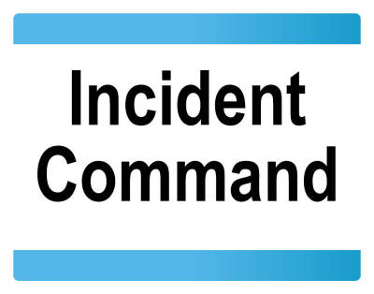
So, beyond the academic world, does classification really matter?
It matters only to the extend that Incident Command must recognize that a Type III event will be easier to find beds.

Slide 46
So, beyond the academic world, does classification really matter? (cont.)
A Type II event will be competing with the trauma service line for resources

Slide 47
So, beyond the academic world, does classification really matter? (cont.)
A Type I event may make it difficult for one or more hospitals to receive patients because highways are damaged, airspace compromised, or the physical structure for one or more hospitals are damaged as well.

Slide 48
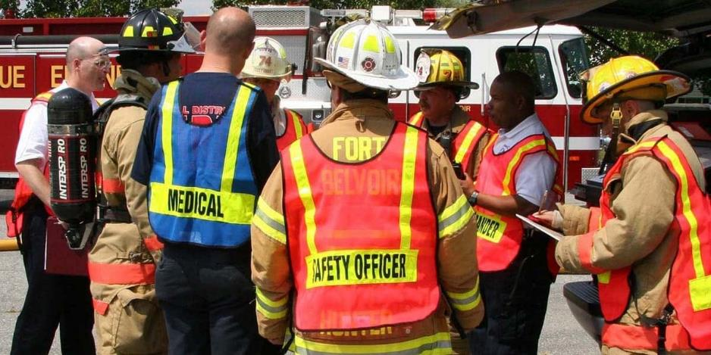
So, beyond the academic world, does classification really matter?
It’s not so important that Incident Command declare what type of BMCI this is, what is important is for IC to understand how this incident may task the system for resources

Slide 49
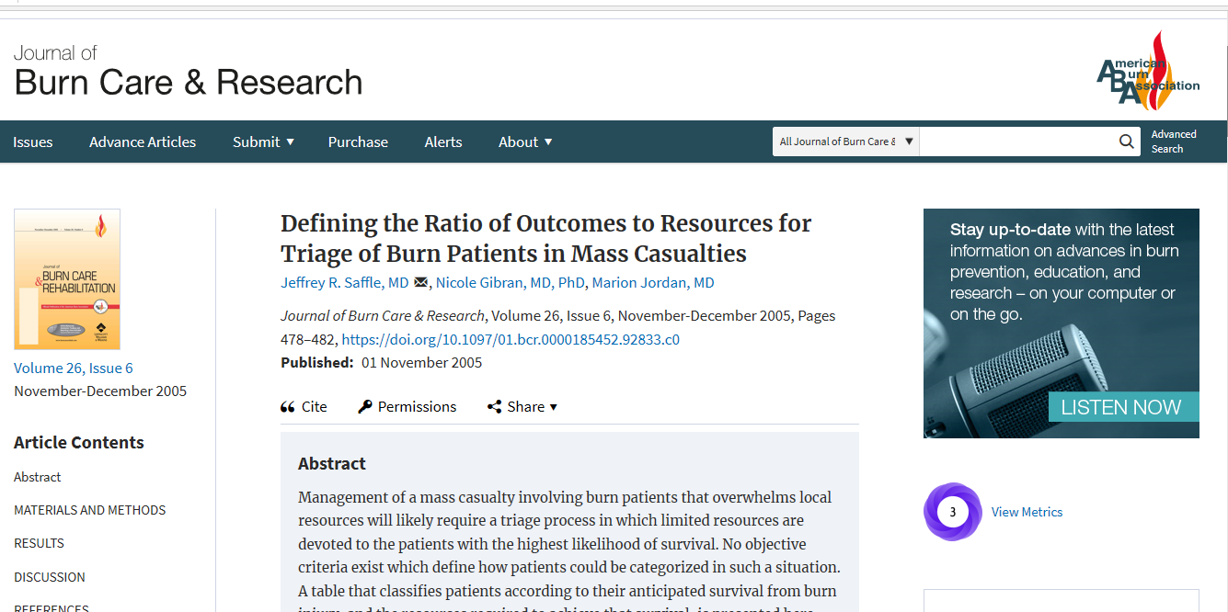
2005, Saffle, Gibran and Jordan collaborated to produce the first iteration of a set of tables to guide clinicians during a disaster where the volume of patients pose the potential to overwhelm resources.

Slide 50
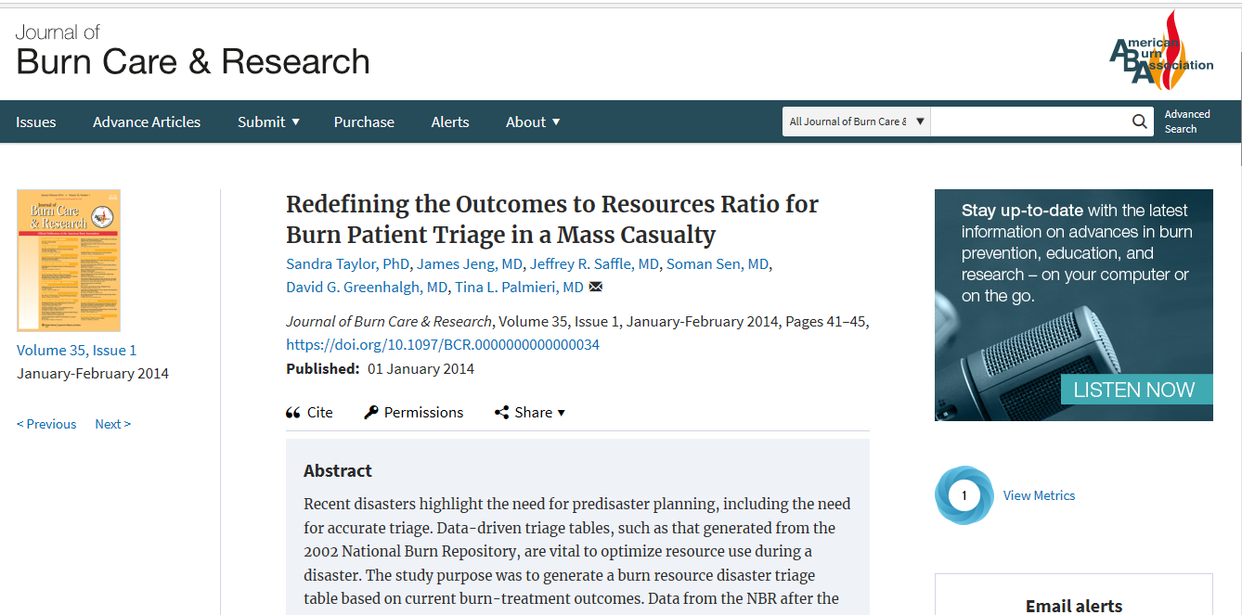
2014, Taylor, Jeng, Saffle, Sen, Greenhalgh and Palmieri, relying in part on new data from the NBR, published a revised (Version 2) set of these tables along with rationale for their use.

Slide 51
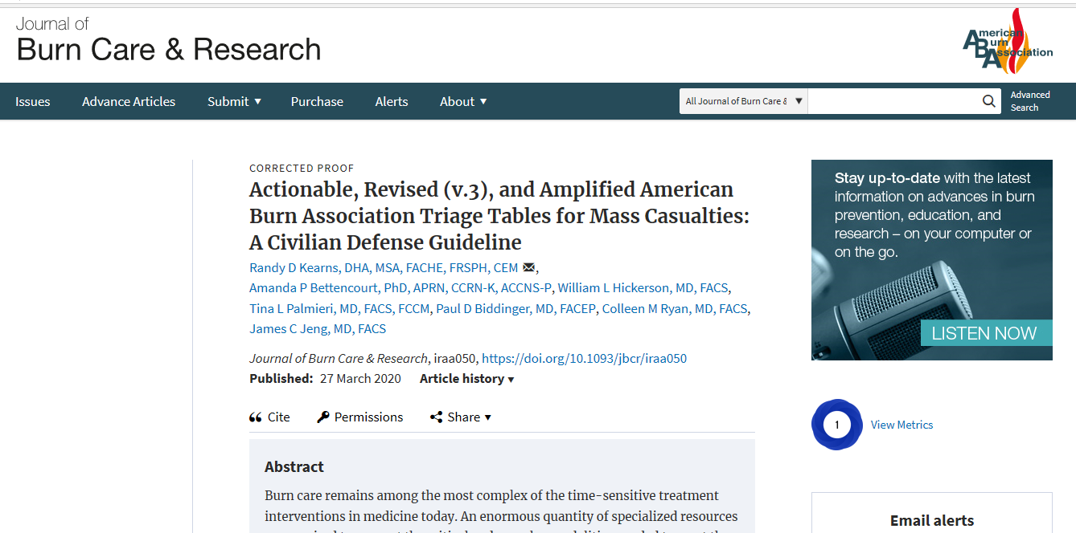
2020, Version 3 was created by Kearns, Bettencourt, Hickerson, Palmieri, Biddinger, Ryan and Jeng, relying in part on new data from the NBR as well as including other considerations for clinicians when confronted with a Burn Mass Casualty Incident.

Slide 52

Steps taken to develop the current set of Triage Tables, V3
We reviewed the Triage Tables- Seriously Resource-Strained Situations (Version 2),
We also reviewed the literature from various BMCIs related to triage methods.
Relying on a multidisciplinary team of burn experts, four new triage tables were developed to assist secondary burn center triage during disasters.
These prototype tables were tested in a BMCI functional exercise.

Slide 53
Results
We created four tables designed to sort patients into three triage categories:
Outpatient status or non-burn center with burn center consultation for patients with ABA referral criteria;

Slide 54
Results
We created four tables designed to sort patients into three triage categories:
Burn center;

Slide 55
Results
We created four tables designed to sort patients into three triage categories:
Expectant care or secondary triage awaiting further resources. Category assignment was based on age and burn size.

Slide 56
Results (cont.)
The first three tables align with the National Academies guidelines; (Conventional, Contingency, and Crisis Care).

Slide 57
Results (cont.)
However, comparing conventional capacity of the national burn care system (approximately 2000 beds) to the current national disaster planning scenarios, we recommend dividing crisis care (adding a fourth echelon when burn injuries are considered) to reflect the profound gap between current capacity and potential demand in certain scenarios.

Slide 58
Results (cont.)
Nationally, the burn care community could manage approximately 2000 patients if time permits (up to 120 hours) and transportation resources exist to treat and redistribute the patients to centers across the nation. While crisis care may be the standard at the onset of an incident with 2000 patients, as patients are treated and distributed, surge equilibrium is reached, the standard will revert to contingency or conventional care.

Slide 59
Results (cont.)
For the rare scenario with potentially hundreds of thousands with burn injuries such as hostile military action leading to the detonation of a thermonuclear weapon, or the healthcare system is overwhelmed such as a pandemic event, the catastrophe could create an austere environment for an extended period. Thus, we identified this higher-order crisis type event as catastrophic care.

Slide 60
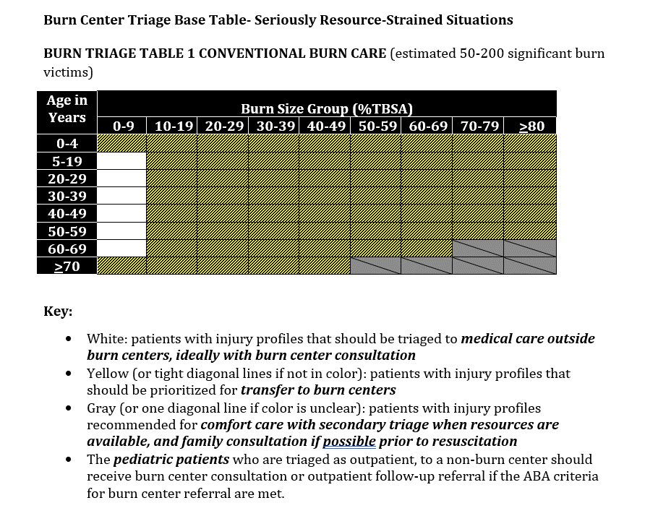
Conventional Surge Capacity

Slide 61
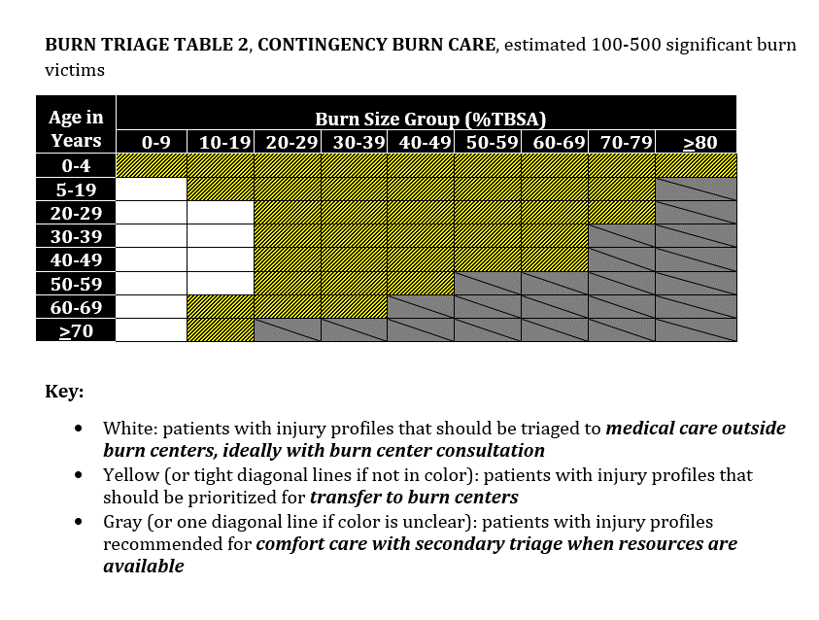
Contingency Surge Capacity

Slide 62
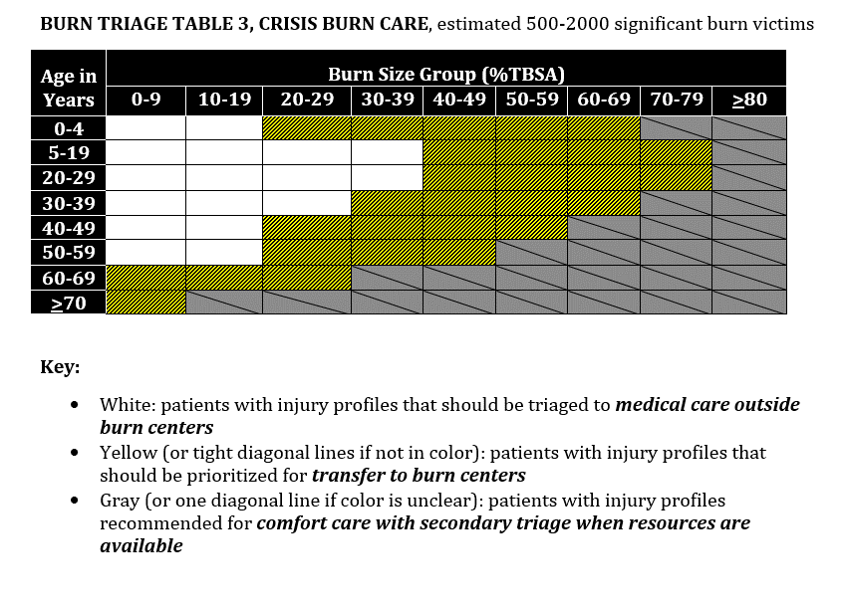
Crisis Surge Capacity
(Anticipated return to Conventional or Contingency Standard of Care in 120 hours)

Slide 63
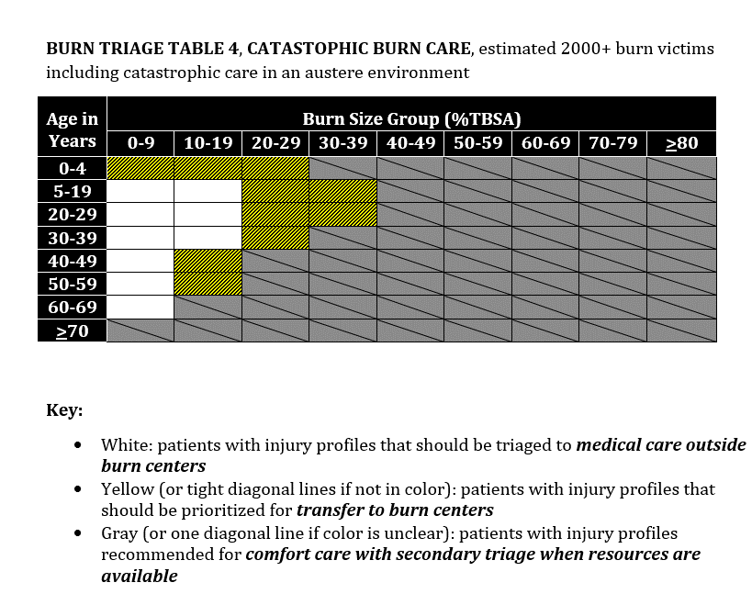
Crisis Surge Capacity (Catastrophic Burn Care)
(Crisis care for indeterminant time period such as following the detonation of a nuclear weapon or a global pandemic.)

Slide 64

Conclusion
Of the nearly 1,000,000 hospital beds in the US healthcare system, there are approximately 2000 beds found in burn centers in the US healthcare system
The supply of burn beds typically meets the demand, so the approximately 2000 meets much of the day-to-day needs. For disasters, that system can be quickly overwhelmed.
Local burn center can offer advice
There are regional burn center disaster coordinators who can also assist
The American Burn Association can provide physician consultation for large scale events

Slide 65


5 Things from this module
The two most significant predictors of outcomes following a burn injury is TBSA and age.
The three most common mistakes in managing a burn injury are incorrect TBSA assessment, hypothermia and excessive resuscitation
There are far fewer burn beds than trauma beds in the US healthcare system
For blast injuries, burn injuries may be distracting and lead to overlooking traumatic injuries
Rule of nines is the simple and easiest approach for emergency assessment for the TBSA

Slide 66
Thank You.
rkearns@uno.edu

Slide 67
References
1. Committee on Crisis Standards of Care ATfI, Triggers, Board on Health Sciences P, Institute of M. In: Hanfling D, Hick JL, Stroud C, eds. Crisis Standards of Care: A Toolkit for Indicators and Triggers. Washington (DC): National Academies Press (US). Copyright 2013 by the National Academy of Sciences. All rights reserved.; 2013.
2. Saffle JR, Gibran N, Jordan M. Defining the ratio of outcomes to resources for triage of burn patients in mass casualties. J Burn Care Rehabil. 2005;26(6):478-482.
3. Taylor S, Jeng J, Saffle JR, Sen S, Greenhalgh DG, Palmieri TL. Redefining the outcomes to resources ratio for burn patient triage in a mass casualty. J Burn Care Res. 2014;35(1):41-45.
4. Tompkins RG. Survival from burns in the new millennium: 70 years' experience from a single institution. Annals of surgery. 2015;261(2):263-268.
5. Goverman J, Mathews K, Nadler D, et al. Satisfaction with life after burn: A Burn Model System National Database Study. Burns : journal of the International Society for Burn Injuries. 2016;42(5):1067-1073.
6. National Academies of Sciences E, Medicine. A National Trauma Care System: Integrating Military and Civilian Trauma Systems to Achieve Zero Preventable Deaths After Injury. Washington, DC: The National Academies Press; 2016.
7. Wachtel TL, Cowan ML, Reardon JD. Developing a regional and national burn disaster response. J Burn Care Rehabil. 1989;10(6):561-567.
8. Gamelli RL, Purdue GF, Greenhalgh DG, et al. Disaster Management and the ABA Plan. J Burn Care Rehabil. 2005;26(2):102-106.
9. Barillo DJ, Dimick AR, Cairns BA, Hardin WD, Acker JE, 3rd, Peck MD. The Southern Region burn disaster plan. J Burn Care Res. 2006;27(5):589-595.
10. Kearns R, Holmes Jt, Cairns B. Burn disaster preparedness and the southern region of the United States. Southern medical journal. 2013;106(1):69-73.
11. Petinaux B, Valenta AL, Deatley C, Conlon KM, Ott JD, Jeng JC. District of Columbia Emergency Healthcare Coalition Burn Mass Casualty Plan: Development to Exercise Date. J Burn Care Res. 2017;38(1):e299-e305.
12. Yurt RW, Lazar EJ, Leahy NE, et al. Burn disaster response planning: an urban region's approach. J Burn Care Res. 2008;29(1):158-165.
13. Leahy NE, Yurt RW, Lazar EJ, et al. Burn disaster response planning in New York City: updated recommendations for best practices. J Burn Care Res. 2012;33(5):587-594.
14. Conlon KM, Ruhren C, Johansen S, et al. Developing and implementing a plan for large-scale burn disaster response in New Jersey. J Burn Care Res. 2014;35(1):e14-20.

Slide 68
References cont.
15. Vandenberg V, Amara R, Crabtree J, Fruhwirth K, Rifenburg J, Garner W. Burn surge for Los Angeles County, California. J Trauma. 2009;67(2 Suppl):S143-146.
16. Kearns RD, Cairns BA, Holmes IV JH, Sagraves SG. The North Carolina Burn Surge Disaster Plan for Emergency Medical Services and Hospitals. University of North Carolina. www.ncburndisaster.org. Published 2012. Updated March 31, 2012. Accessed Jan 30, 2014.
17. Hickerson WL, Ryan CM, Conlon KM, et al. What's in a Name? Recent Key Projects of the Committee on Organization and Delivery of Burn Care. J Burn Care Res. 2015;36(6):619-625.
18. Jeng JC. A Quartet of American Burn Association Clinical Guidelines for Austere Condition Burn Care: Gestation, Collaboration, Future Impact, and Post Humus Dedication. J Burn Care Res. 2017;38(5):e883.
19. Kearns RD, Conlon KM, Matherly AF, et al. Guidelines for Burn Care Under Austere Conditions: Introduction to Burn Disaster, Airway and Ventilator Management, and Fluid Resuscitation. J Burn Care Res. 2016;37(5):e427-439.
20. Cancio LC, Barillo DJ, Kearns RD, et al. Guidelines for Burn Care Under Austere Conditions: Surgical and Nonsurgical Wound Management. J Burn Care Res. 2017;38(4):203-214.
21. Cancio LC, Sheridan RL, Dent R, et al. Guidelines for Burn Care Under Austere Conditions: Special Etiologies: Blast, Radiation, and Chemical Injuries. J Burn Care Res. 2017;38(1):e482-e496.
22. Young AW, Graves C, Kowalske KJ, et al. Guideline for Burn Care Under Austere Conditions: Special Care Topics. J Burn Care Res. 2017;38(2):e497-e509.
23. National Academies of Sciences E, Medicine, Health, et al. The National Academies Collection: Reports funded by National Institutes of Health. In: Wollek S, Kahn B, Pray L, eds. Exploring Medical and Public Health Preparedness for a Nuclear Incident: Proceedings of a Workshop. Vol Updating Planning Assumptions of Nuclear Preparedness. Washington (DC): National Academies Press (US) Copyright 2019 by the National Academy of Sciences. All rights reserved.; 2019.
24. Hick JL, Einav S, Hanfling D, et al. Surge capacity principles: care of the critically ill and injured during pandemics and disasters: CHEST consensus statement. Chest. 2014;146(4 Suppl):e1S-e16S.

Slide 69
References cont.
25. Hick JL, Hanfling D, Cantrill SV. Allocating scarce resources in disasters: emergency department principles. Annals of emergency medicine. 2012;59(3):177-187.
26. Hanfling D, Hick JL, Cantrill SV. Understanding the role for crisis standards of care. Annals of emergency medicine. 2012;60(5):669-670; author reply 670-661.
27. Kearns RD, Holmes JHt, Alson RL, Cairns BA. Disaster planning: the past, present, and future concepts and principles of managing a surge of burn injured patients for those involved in hospital facility planning and preparedness. J Burn Care Res. 2014;35(1):e33-42.
28. Kearns RD, Conlon KM, Valenta AL, et al. Disaster planning: the basics of creating a burn mass casualty disaster plan for a burn center. J Burn Care Res. 2014;35(1):e1-e13.
29. Howe D. Planning Scenarios, Executive Summaries, Created for Use in National, Federal, State, and Local Homeland Security Preparedness Activities. In: Council THS, ed. http://www.globalsecurity.org/security/library/report/2004/hsc-planning-scenarios-jul04_exec-sum.pdf.2004:55.
30. Kearns RD, Cairns BA, Cairns CB. Surge Capacity and Capability. A Review of the History and Where the Science is Today Regarding Surge Capacity during a Mass Casualty Disaster. Front Public Health. 2014;2:29.
31. Kearns RD, Marcozzi DE, Barry N, Rubinson L, Hultman CS, Rich PB. Disaster Preparedness and Response for the Burn Mass Casualty Incident in the Twenty-first Century. Clinics in plastic surgery. 2017;44(3):441-449.
32. Kearns RD, Hubble MW, Holmes JHt, Cairns BA. Disaster planning: transportation resources and considerations for managing a burn disaster. J Burn Care Res. 2014;35(1):e21-32.
33. DiCarlo AL, Maher C, Hick JL, et al. Radiation injury after a nuclear detonation: medical consequences and the need for scarce resources allocation. Disaster medicine and public health preparedness. 2011;5 Suppl 1:S32-44.
34. Emergency System for Advance Registration of Volunteer Health Professionals. http://www.phe.gov/esarvhp/Pages/default.aspx. Published 2012. Accessed June 29, 2012.
35. Jeng J, Gibran N, Peck M. Burn care in disaster and other austere settings. The Surgical clinics of North America. 2014;94(4):893-907.
36. Peck M, Jeng J, Moghazy A. Burn Resuscitation in the Austere Environment. Critical care clinics. 2016;32(4):561-565.

Slide 70
References cont.
37. Federal Emergency Management Agency DoHS. Typed Resource Definitions, Emergency Medical Services Resources. http://www.fema.gov/pdf/emergency/nims/508-3_emergency_medica_%20services_%20resources.pdf. Published 2009. Updated March 2009. Accessed Mar 27 2019, 508-3.
38. Grieve B, Shapiro GD, Wibbenmeyer L, et al. Long-Term Social Reintegration Outcomes for Burn Survivors With and Without Peer Support Attendance: A Life Impact Burn Recovery Evaluation (LIBRE) Study. Arch Phys Med Rehabil. 2020;101(1S):S92-S98.
39. Sheridan RL, Hinson MI, Liang MH, et al. Long-term outcome of children surviving massive burns. Jama. 2000;283(1):69-73.
40. Colohan SM. Predicting prognosis in thermal burns with associated inhalational injury: a systematic review of prognostic factors in adult burn victims. J Burn Care Res. 2010;31(4):529-539.
41. Smith DL, Cairns BA, Ramadan F, et al. Effect of inhalation injury, burn size, and age on mortality: a study of 1447 consecutive burn patients. J Trauma. 1994;37(4):655-659.
42. Gupta K, Mehrotra M, Kumar P, Gogia AR, Prasad A, Fisher JA. Smoke Inhalation Injury: Etiopathogenesis, Diagnosis, and Management. Indian J Crit Care Med. 2018;22(3):180-188.
43. Yang CJ, Tsai SH, Chien WC, et al. The crowd-out effect of a mass casualty incident: Experience from a dust explosion with multiple burn injuries. Medicine. 2019;98(18):e15457.
44. Ryan CM, Antoon A, Fagan SP, et al. Considerations for preparedness for a pediatric burn disaster. J Burn Care Res. 2011;32(5):e165-166.
45. Wolf SE, Rose JK, Desai MH, Mileski JP, Barrow RE, Herndon DN. Mortality determinants in massive pediatric burns. An analysis of 103 children with > or = 80% TBSA burns (> or = 70% full-thickness). Annals of surgery. 1997;225(5):554-565; discussion 565-559.
46. Hodge JG. Revisiting Legal Foundations of Crisis Standards of Care. SSRN Electronic Journal. 2019.
47. Gostin LO, Hanfling D, Hodge JG, Jr., Courtney B, Hick JL, Peterson CA. Standard of care--in sickness and in health and in emergencies. The New England journal of medicine. 2010;363(14):1378-1379; author reply 1380.
48. Fink SL. Five days at Memorial: Life and death in a storm-ravaged hospital. Atlantic Books Ltd; 2013.
49. Armstrong JR, Willand L, Gonzalez B, Sandhu J, Mosier MJ. Quantitative Analysis of Estimated Burn Size Accuracy for Transfer Patients. J Burn Care Res. 2017;38(1):e30-e35.

Slide 71
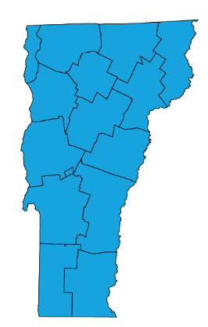


Content for this Presentation was Created or Developed by Randy Kearns for All Clear Emergency Management Group to be used for the State of Vermont
Dr. Kearns began his career as a paramedic, rescue chief and firefighter and instructor. Over 30 years, he taught emergency services programs at several community colleges in the Carolinas, spent 8 years in hospital administration and led multiple emergency service and emergency management organizations. Dr. Kearns has been a responder to 25+ presidentially declared disasters as a local, state and federal representative. In 2014, Dr. Kearns retired (from the State of North Carolina) as a Clinical Assistant Professor at the University of North Carolina, School of Medicine. After spending four years as the Healthcare Management Program Chair and an Associate Professor at the University of Mount Olive, Dr. Kearns joined the faculty here at the University of New Orleans in the College of Business Administration, August 2018.
Publication Indexes:
PubMed
Scopus
ResearchGate
ORCID
Dr. Kearns has 81 publications in various forms. And, according to Expertscape (www.expertscape.com an academic artificial intelligence analysis software) is ranked 4rd internationally for research in “Surge Capacity” 5th internationally for research in “Mass Casualty Incidents” and 11th for his work in “Disaster Planning.”
All Clear Emergency Management Group, LLC is an experienced consulting firm that provides an array of emergency management services and conference management services. Our team of dedicated professionals will exceed our clients’ expectations.

Slide 72
Assignment of Rights
This content was developed for the All Clear Emergency Management Group for use with the State of Vermont.
Content used for this presentation, where applicable, has been sourced from various public documents or from the author’s personal materials. Copyright for papers published in academic journals, in their final form, are maintained by those respective journals.
The purpose of this project is to provide education for those involved in emergency care for those with a burn injury. Reuse of this material in their current format is restricted to All Clear Emergency Management Group for use with the State of Vermont.
All other rights to the materials are retained by the author.

Slide 73

Fair Use and Disclaimer
Images and other content found throughout this presentation are either cited for their original source, are owned by the author of this work or were commonly found on the world wide web and not identified as being protected images (copyright). These images and this content are used and protected based on the Fair Use Doctrine.
Copyright Disclaimer Under Section 107 of the Copyright Act 1976, allowance is made for "fair use" for purposes such as criticism, comment, news reporting, teaching, scholarship, and research. Fair use is a use permitted by copyright statute that might otherwise be infringing. Non-profit, educational or personal use tips the balance in favor of fair use.
If for any reason you see an image that may in fact be copyrighted or you find objectionable, please notify us immediately.

